Slide 1
Potter’s Village
Kisoro, Uganda
Charity No. 1126101

Slide 2
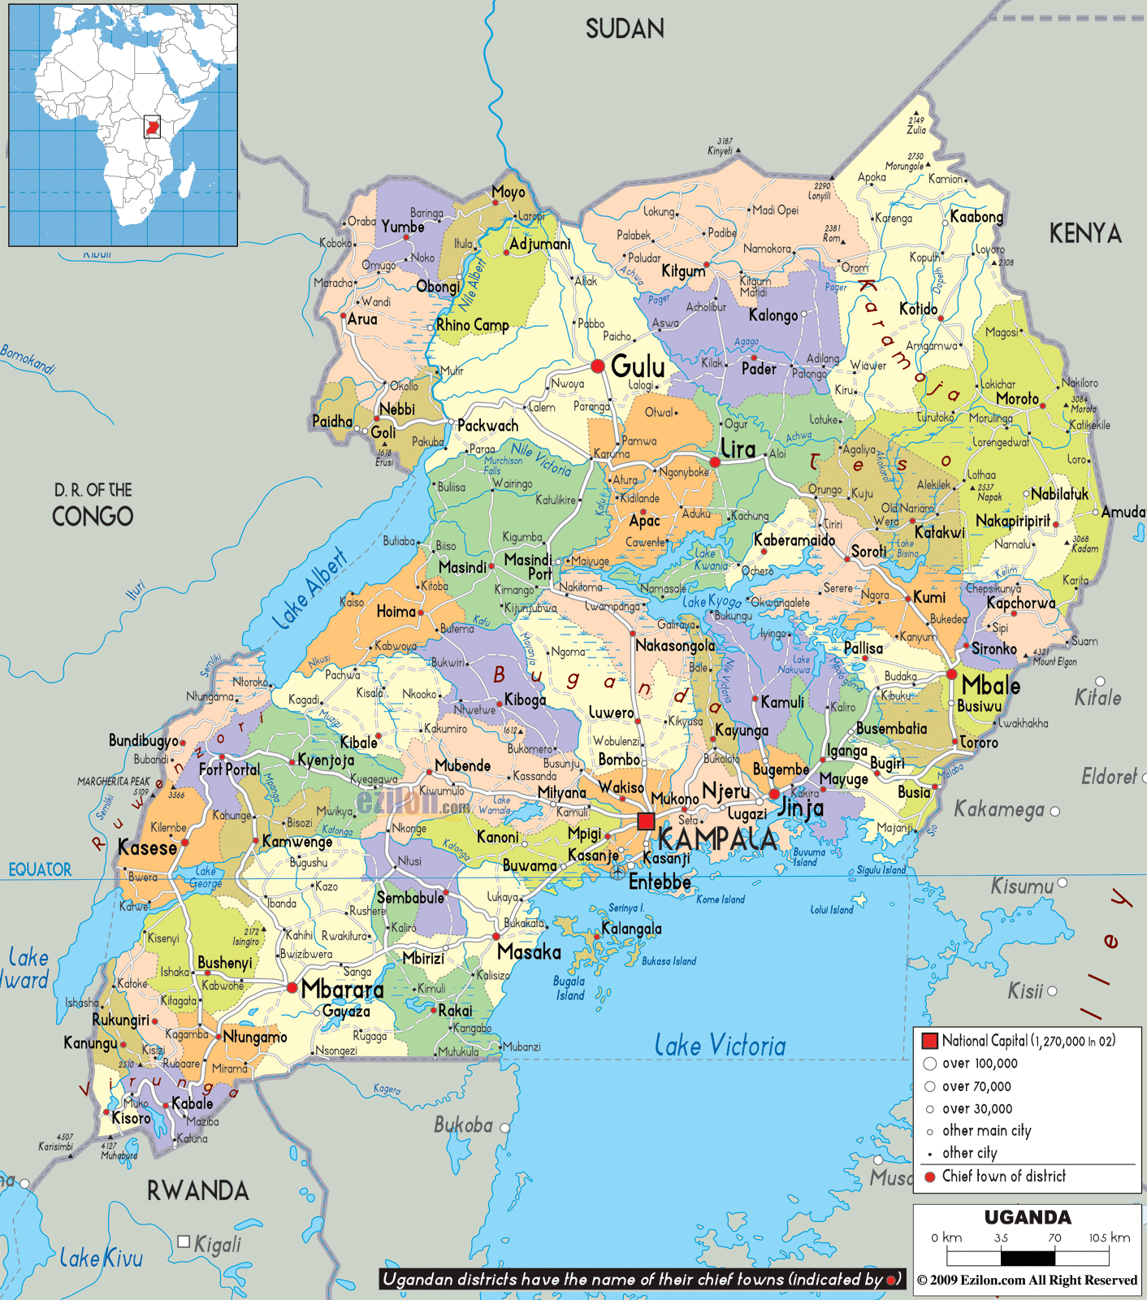
KISORO

Slide 3
The pearl of Africa

Slide 4
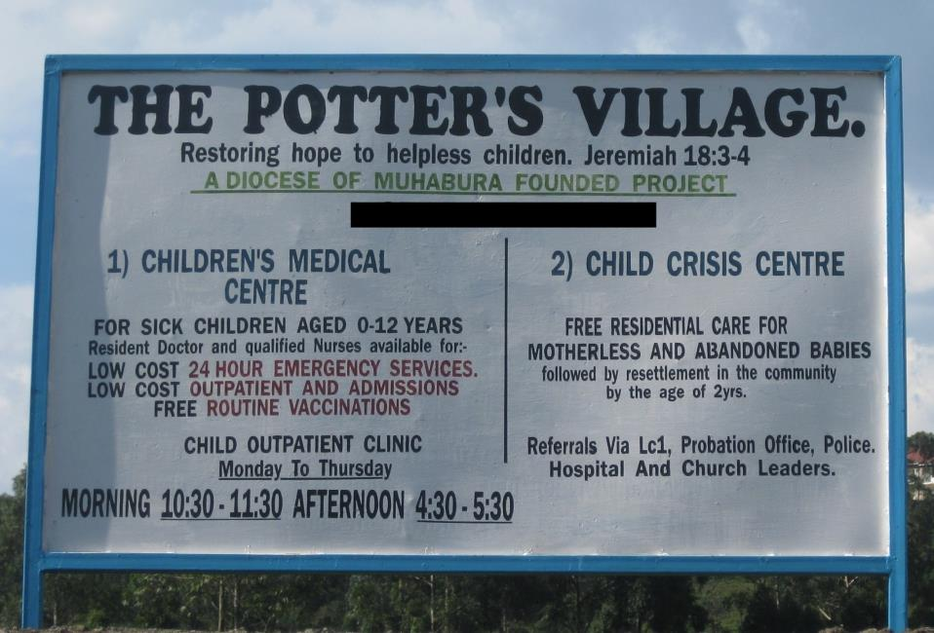

Slide 5
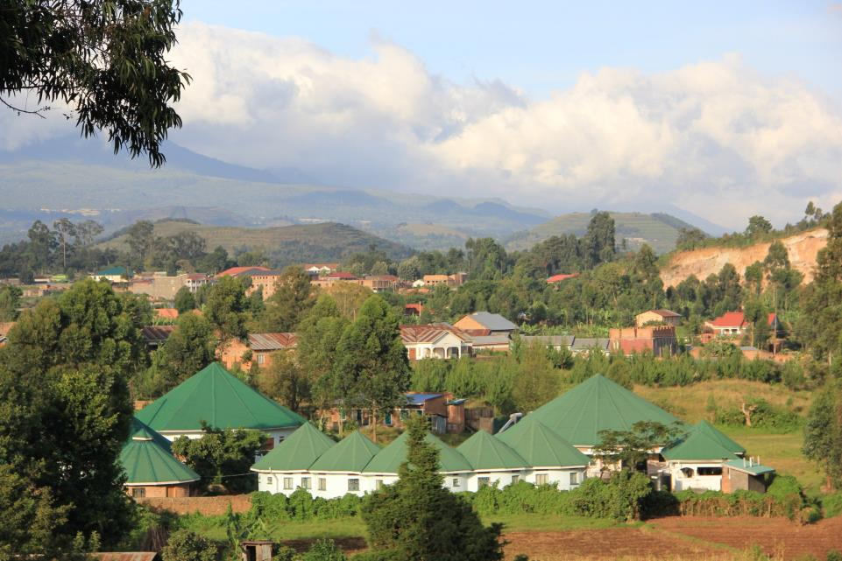
Since 2007 Potter’s Village had grown from a scrubby plot of land to the amazing project we see today.

Slide 6
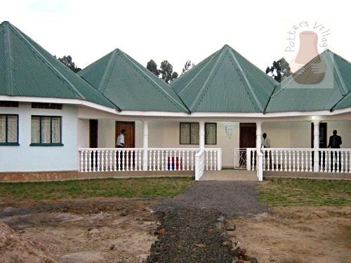
The first building build was the babies accommodation block,
built in 2007

Slide 7
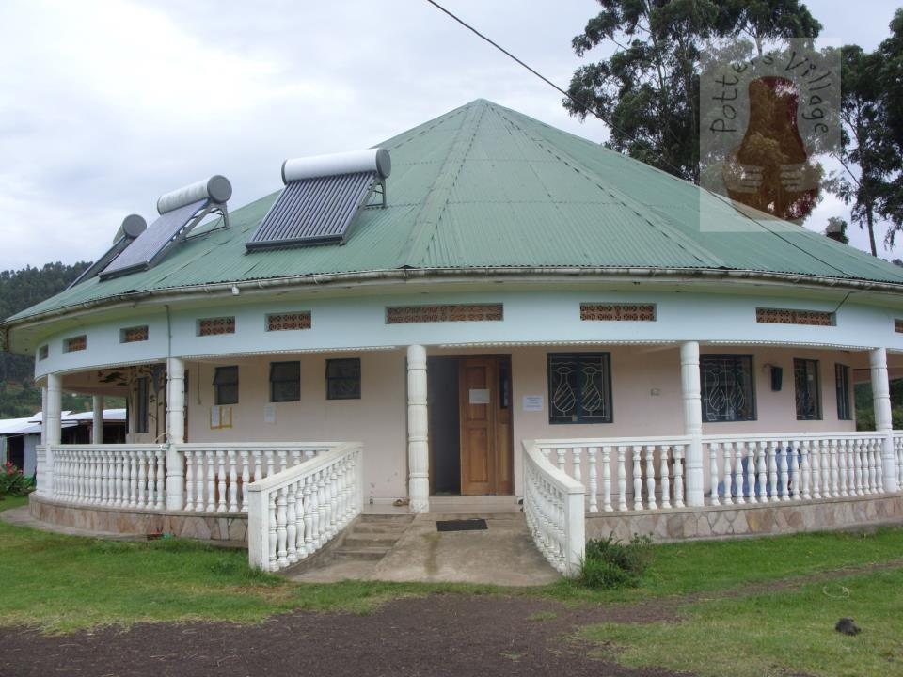
The next building to be built was the Medical Centre

Slide 8
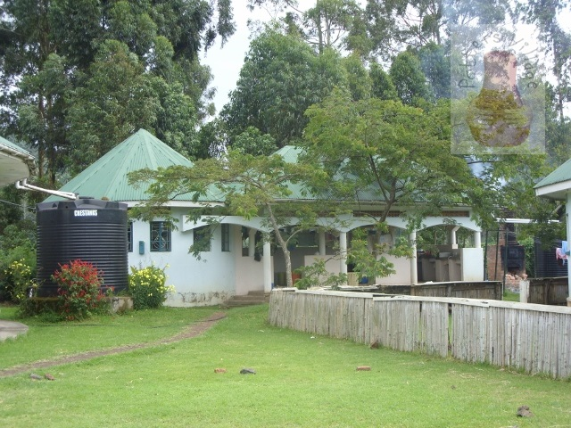
Then the laundry, to cope will all the nappies!

Slide 9
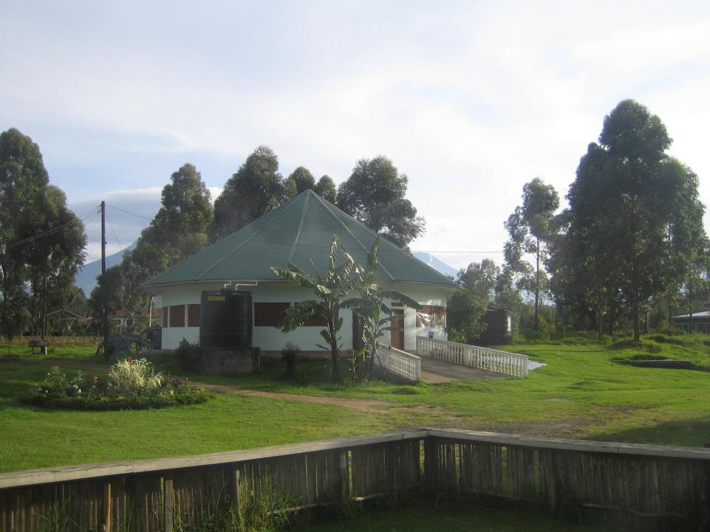
After that, came the day centre……..

Slide 10
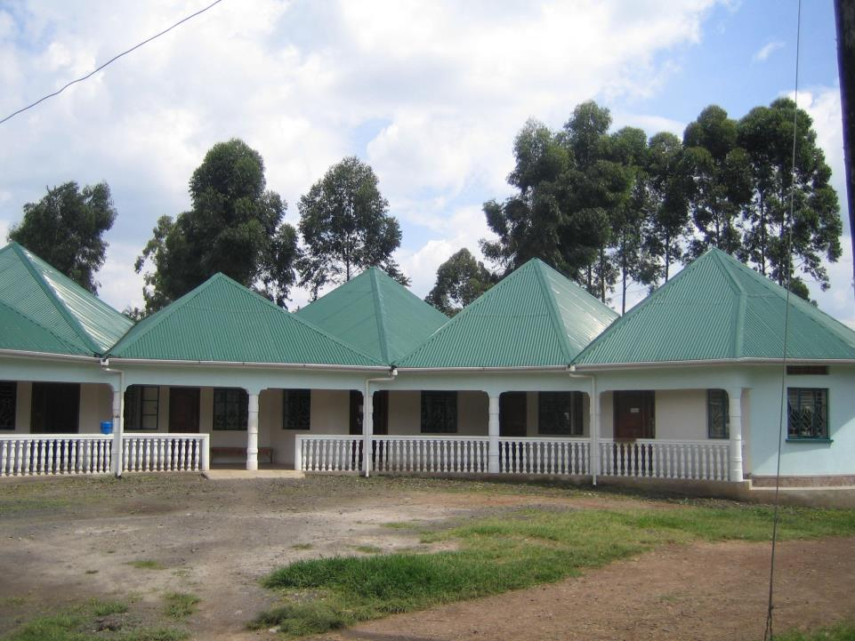
The Admin/Accomodation block completed in 2012

Slide 11
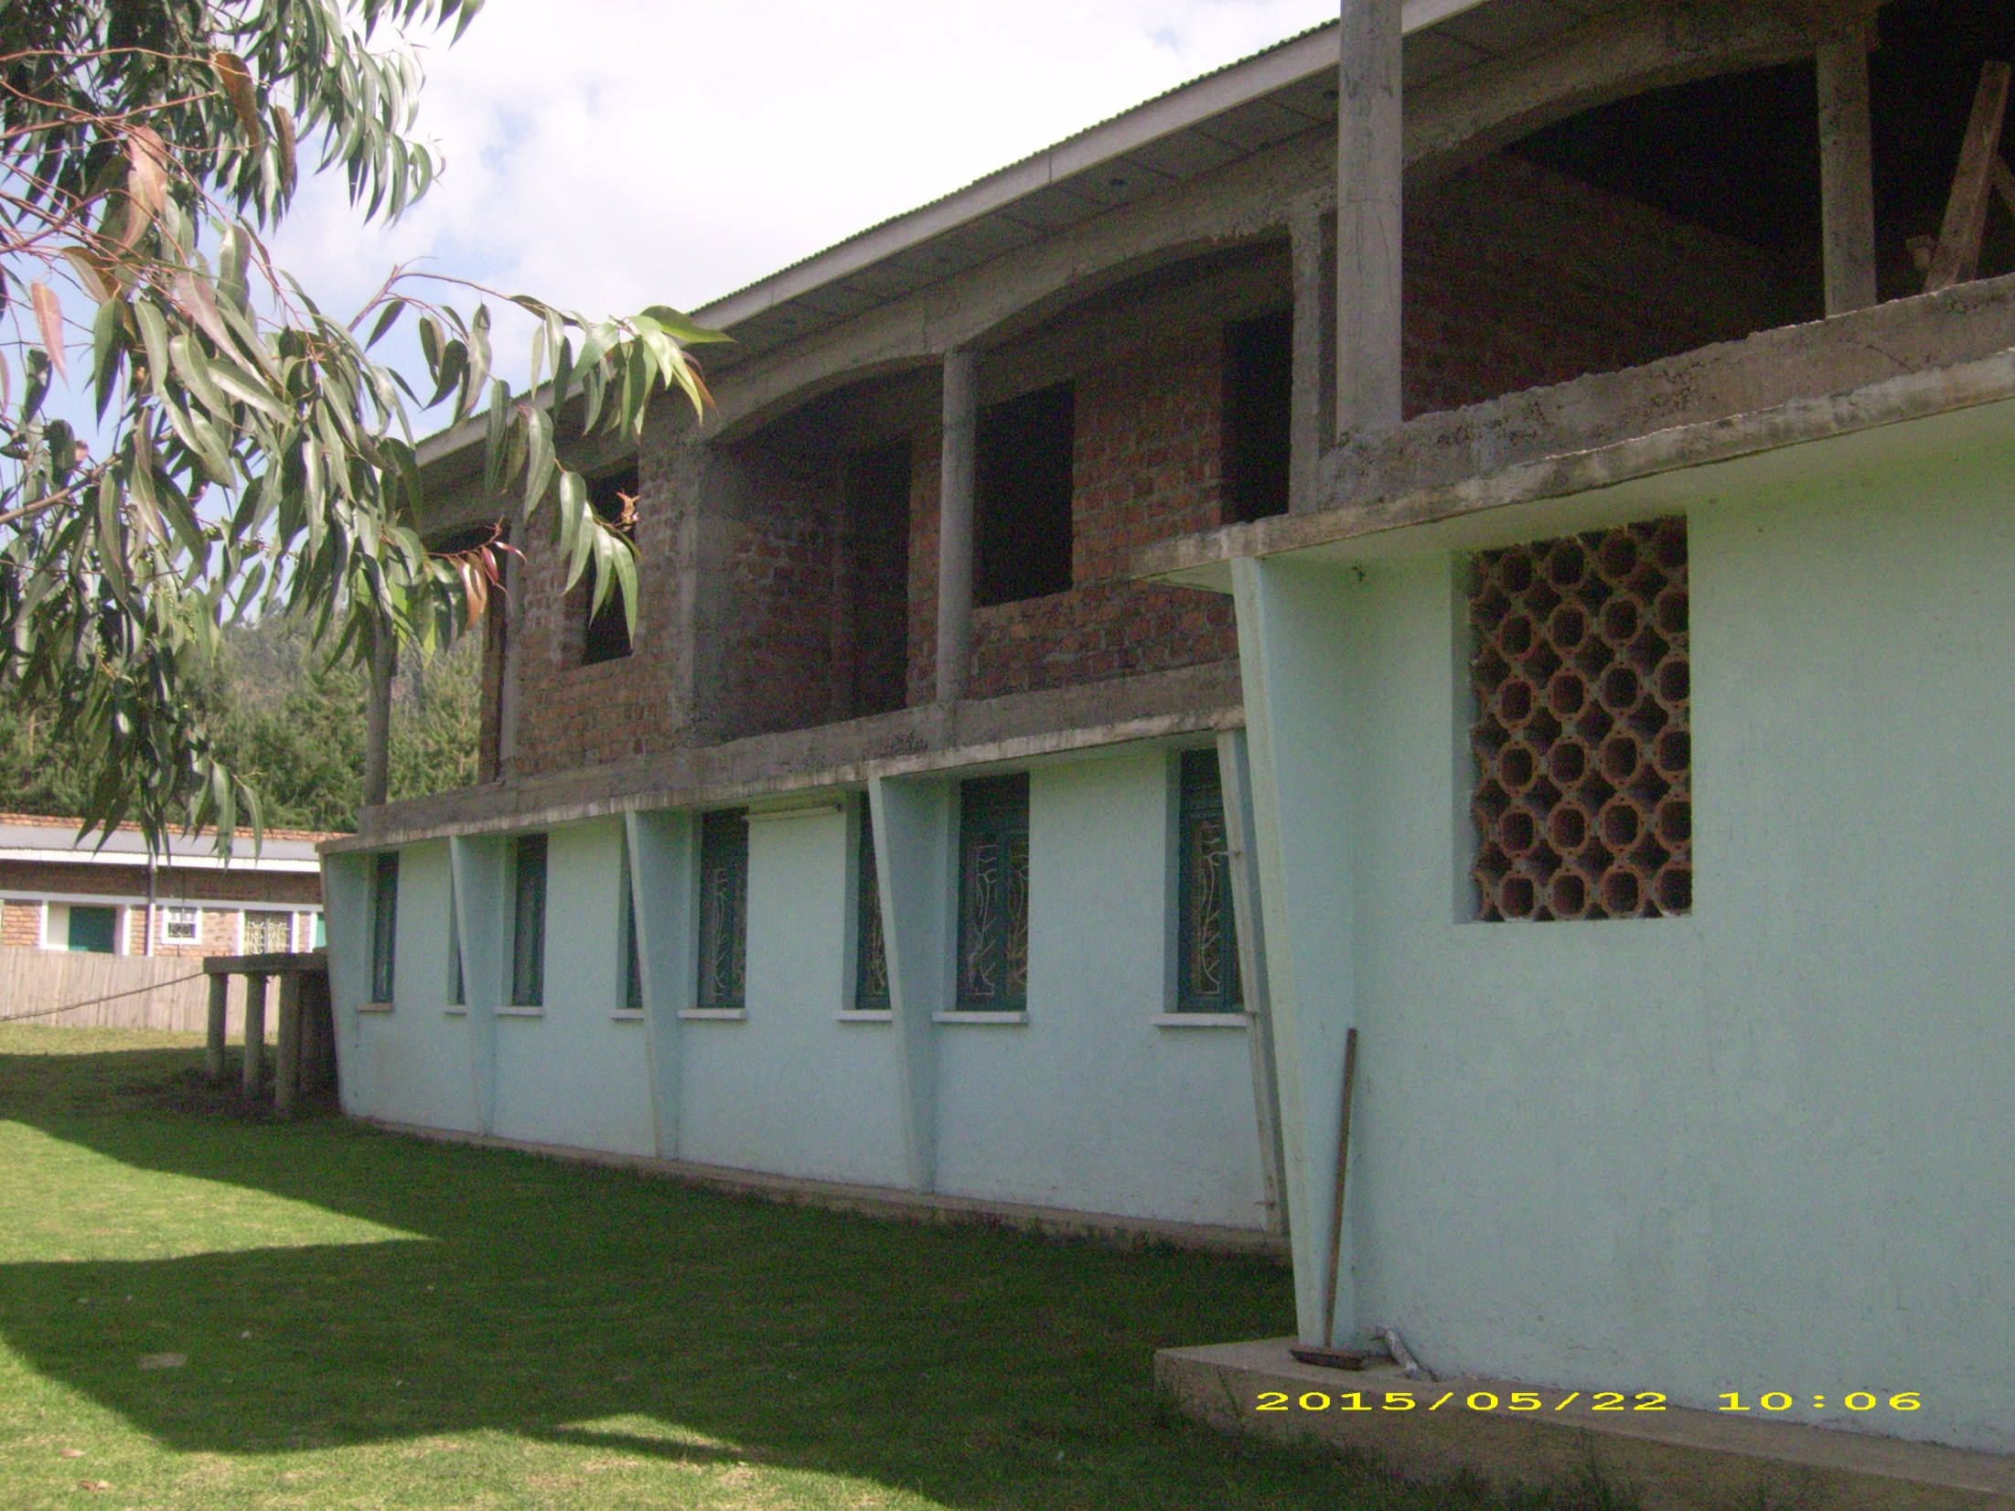
Finally the hostel building. We hope to complete the second stage (top floor) in 2016.

Slide 12
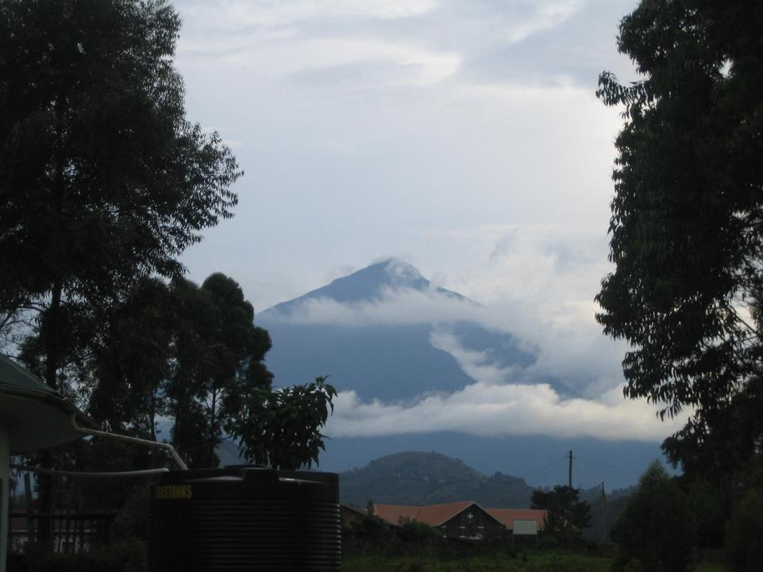
Kisoro district is very beautiful.
Mount Muhabura

Slide 13
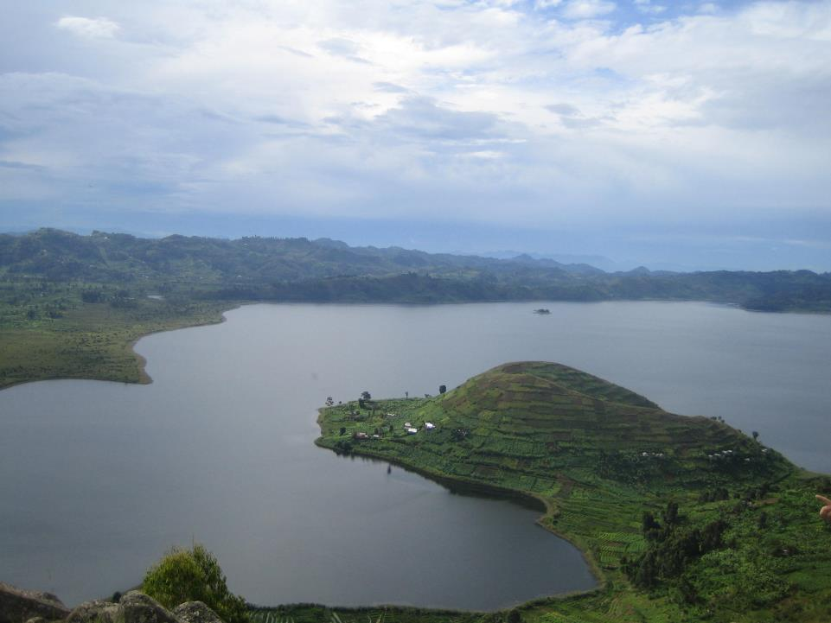
Lake Mutanda

Slide 14
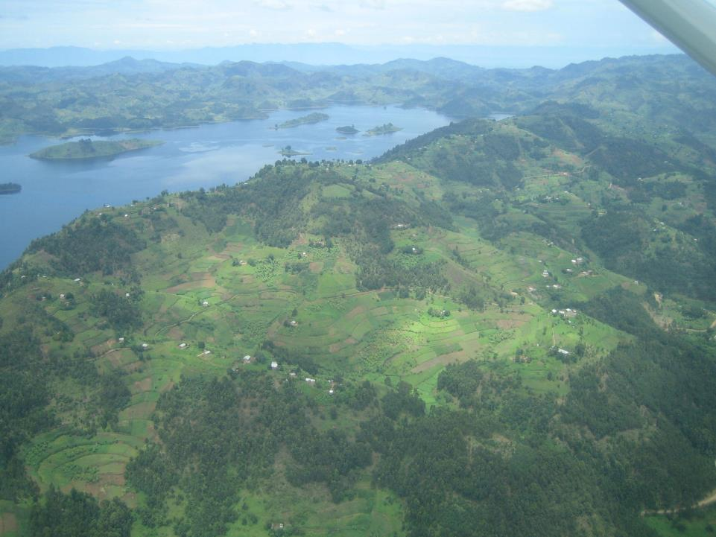
Lake Bunyonyi

Slide 15
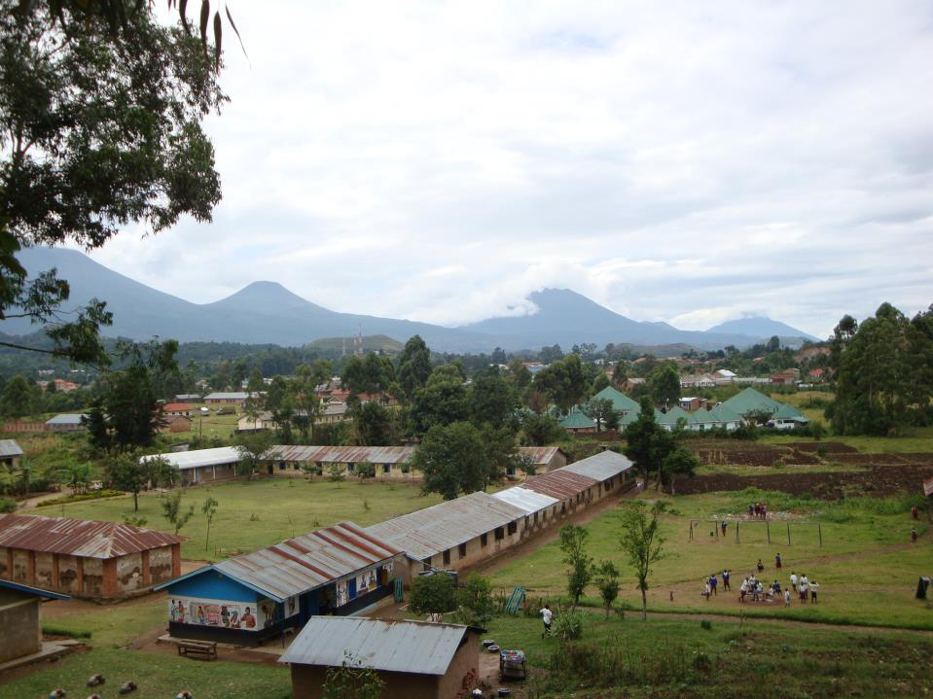
The Virunga Volcanoes

Slide 16
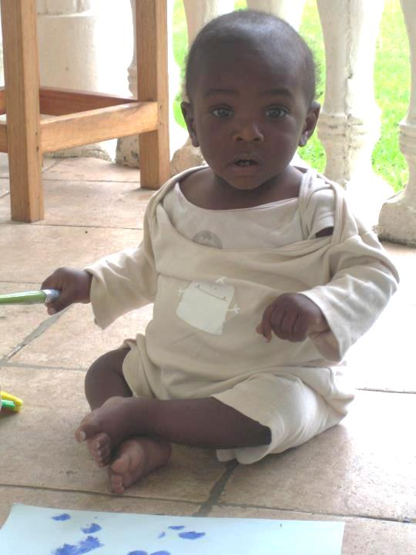
But our focus is on the children.
Potter’s Village cares for up to 20 children on site

Slide 17
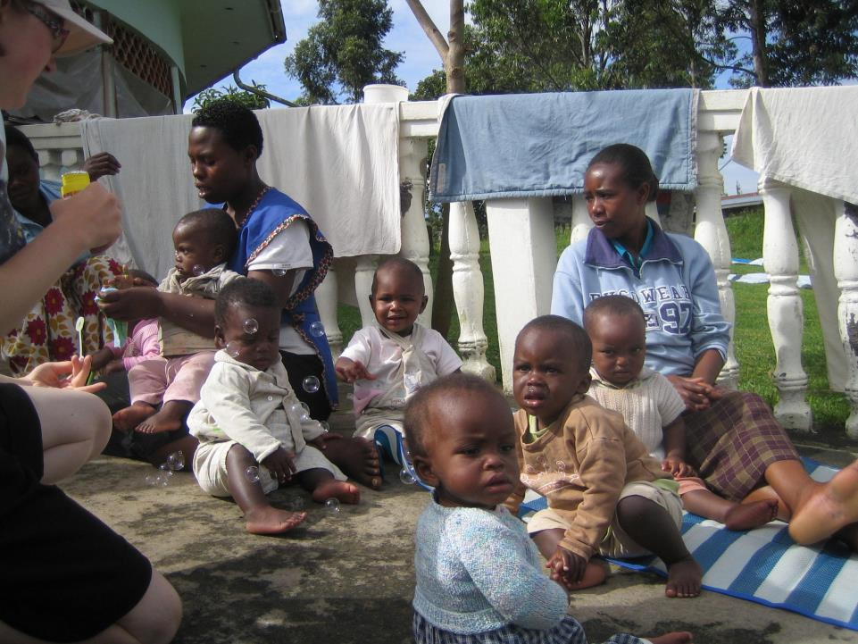

Slide 18
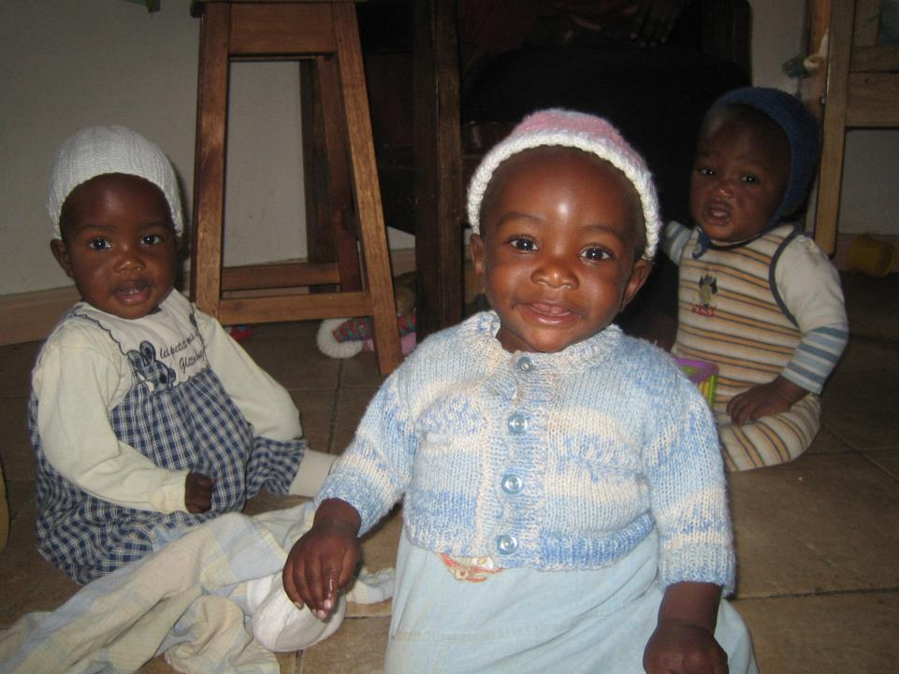
They are lovely

Slide 19
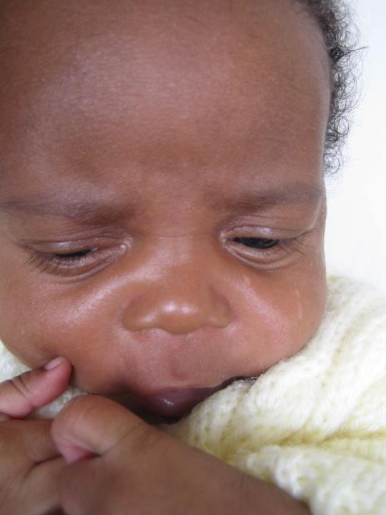

Slide 20
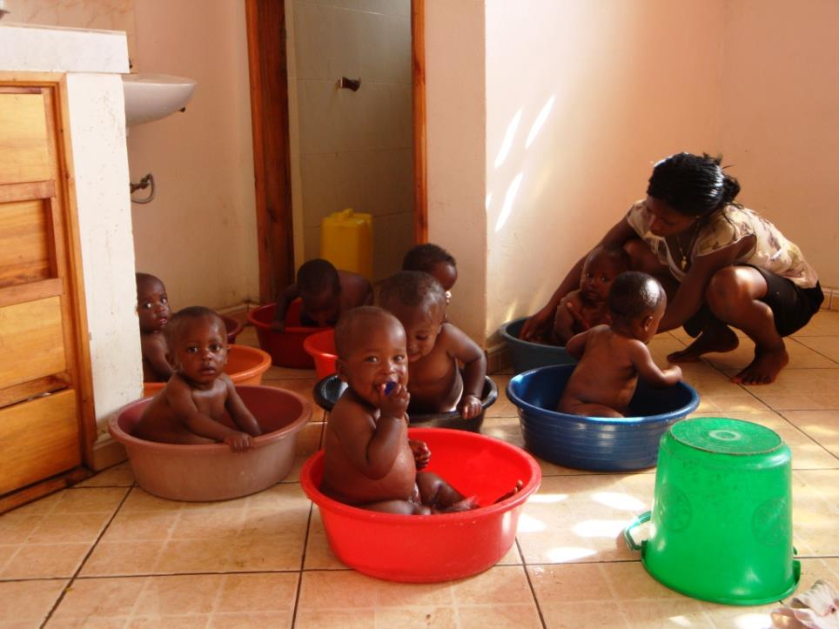
Bath time!!

Slide 21
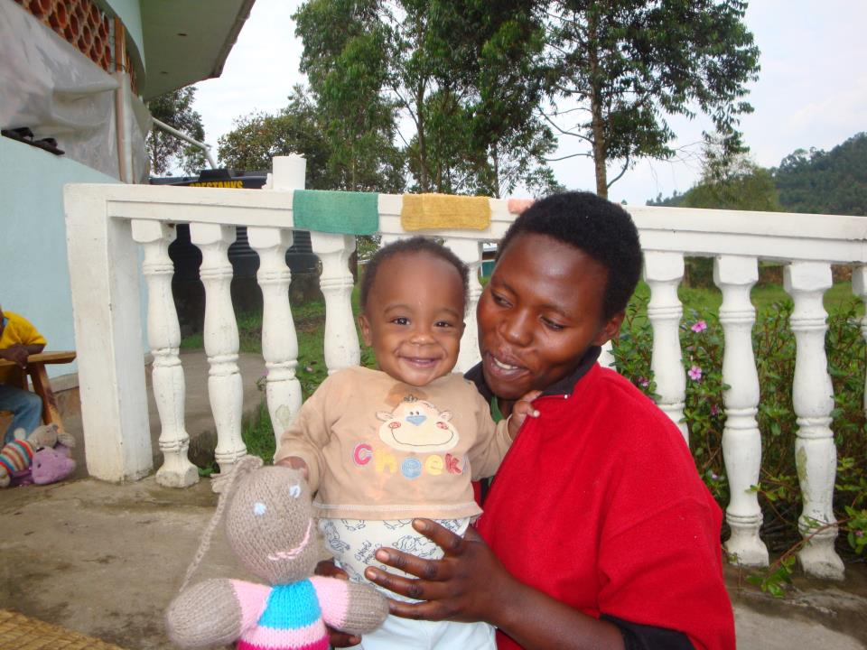

Slide 22
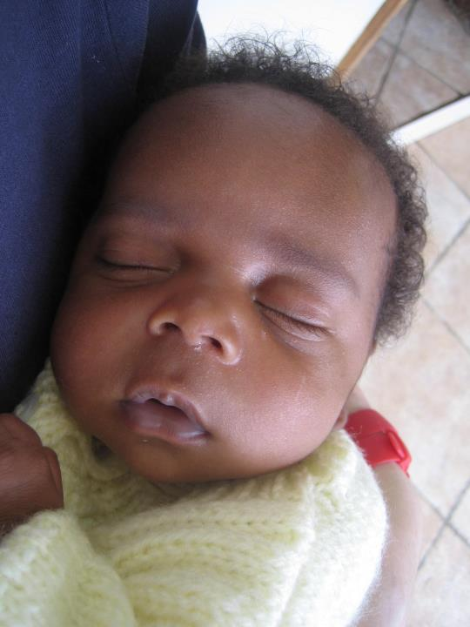

Slide 23
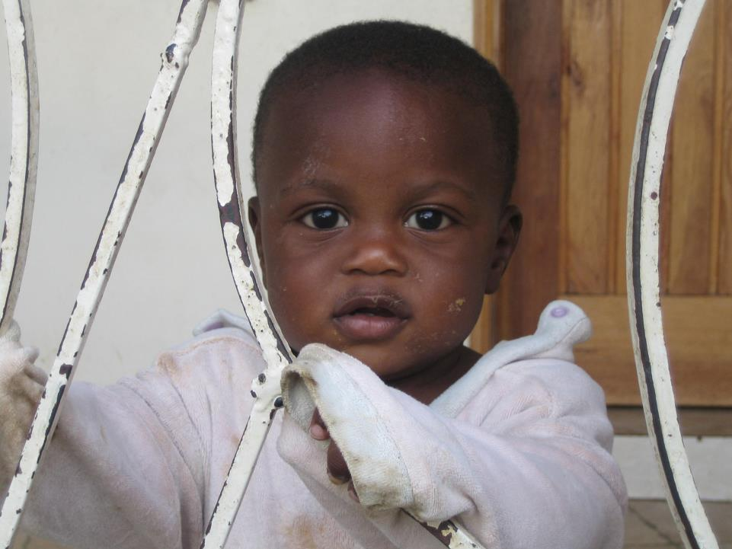

Slide 24
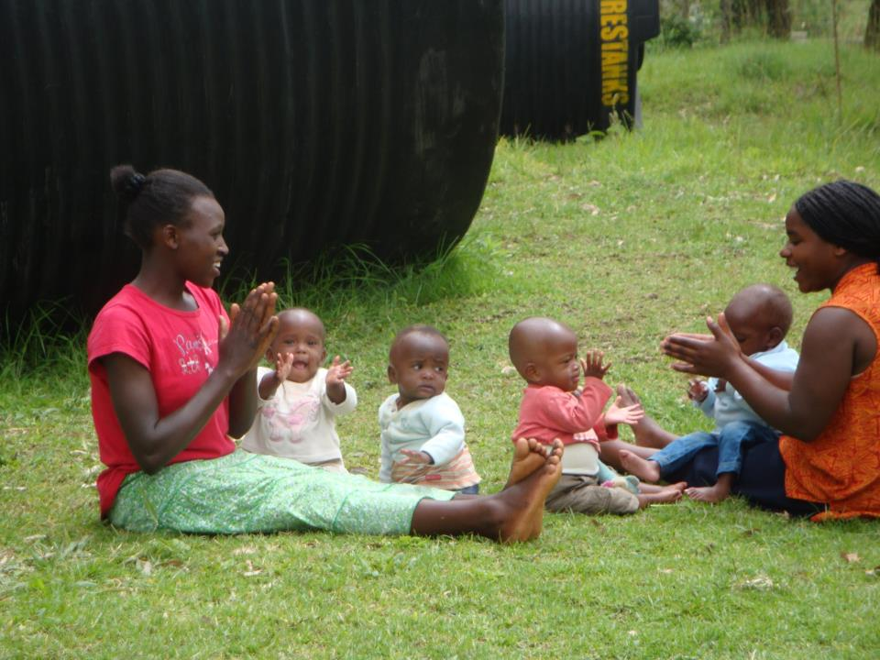
They love a sing a long….

Slide 25
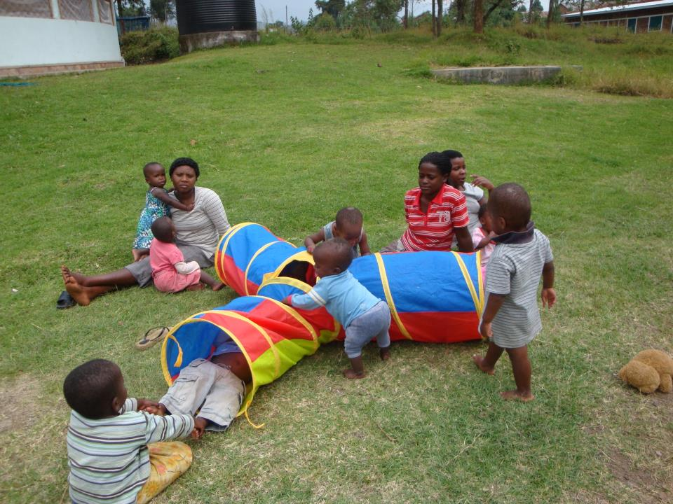
Play time is great…!

Slide 26
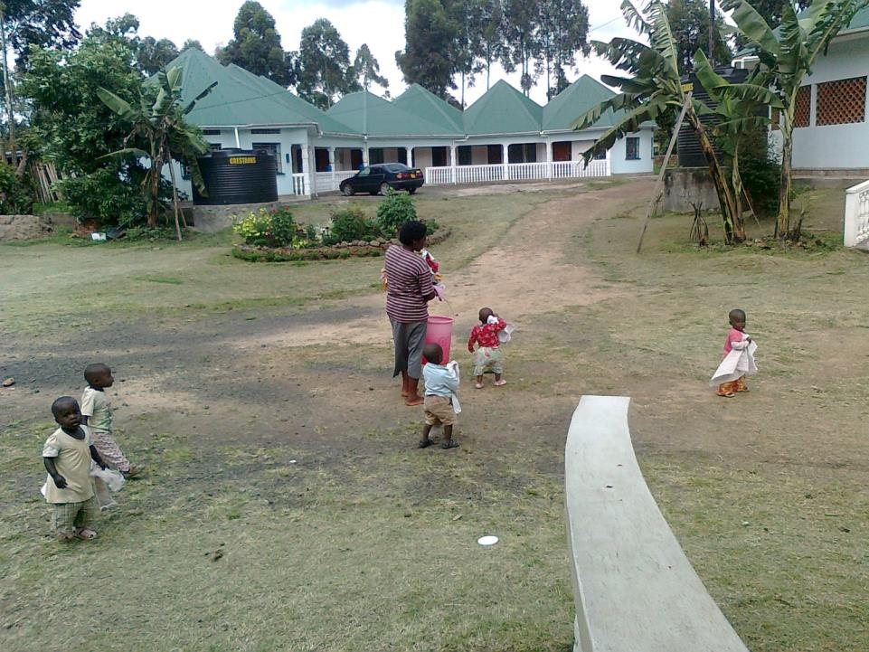
And sometimes they even help with the laundry!!

Slide 27
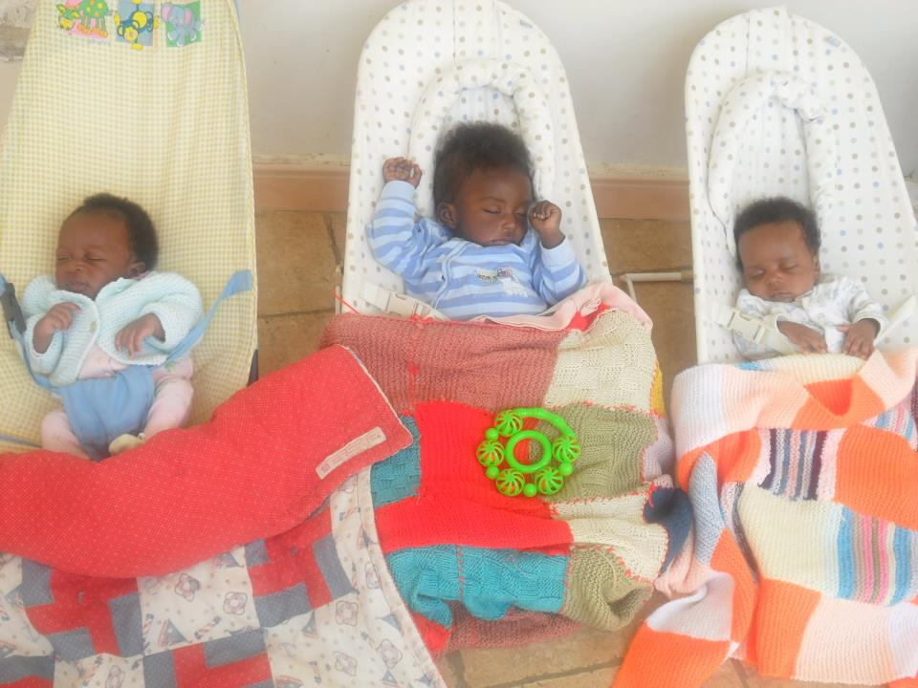

Slide 28
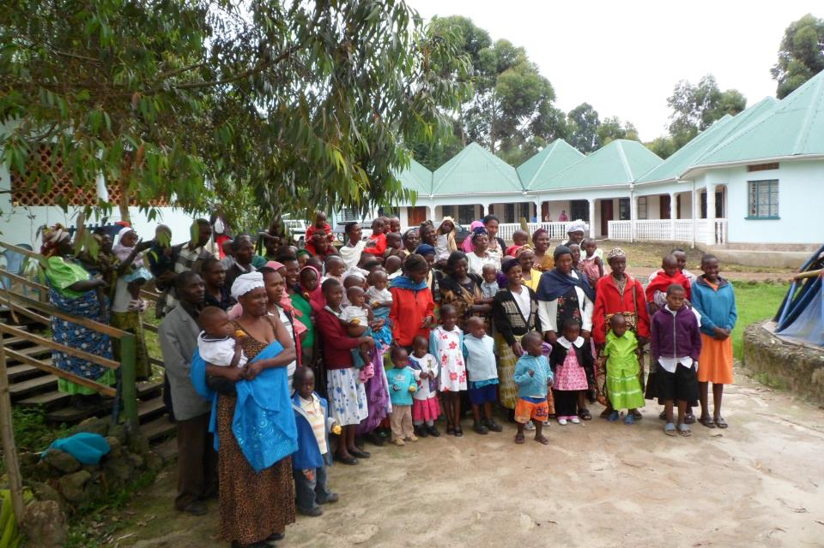
Community support children. Potter’s Village currently supports 70 children who live with family or foster carers

Slide 29
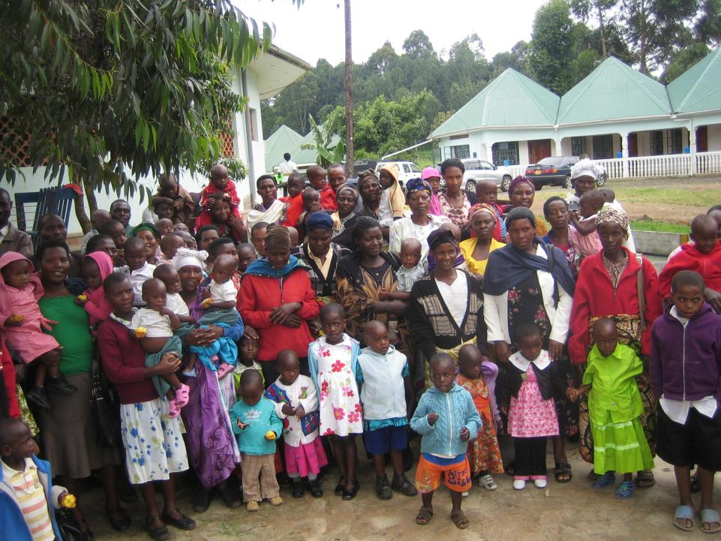

Slide 30
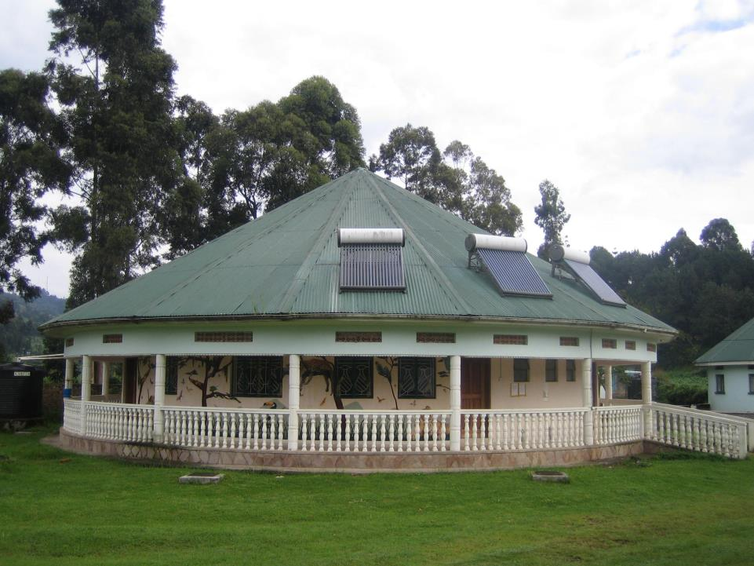
The Potter’s Village Medical centre is becoming a critical service within the community, especially the unit caring
for premature babies.

Slide 31
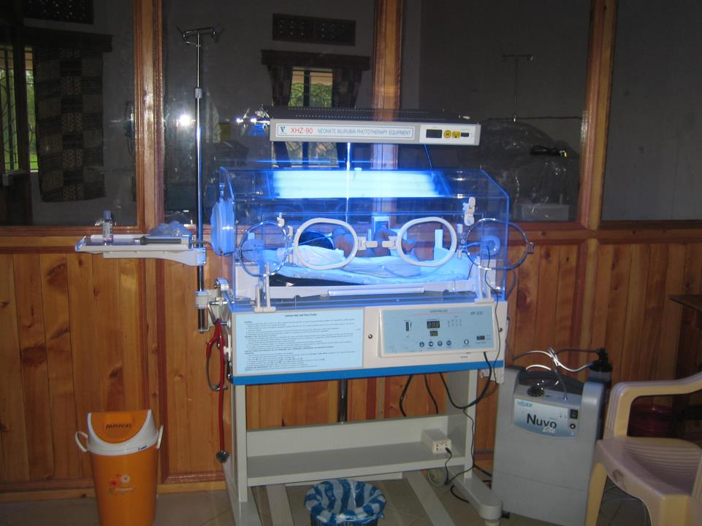

Slide 32
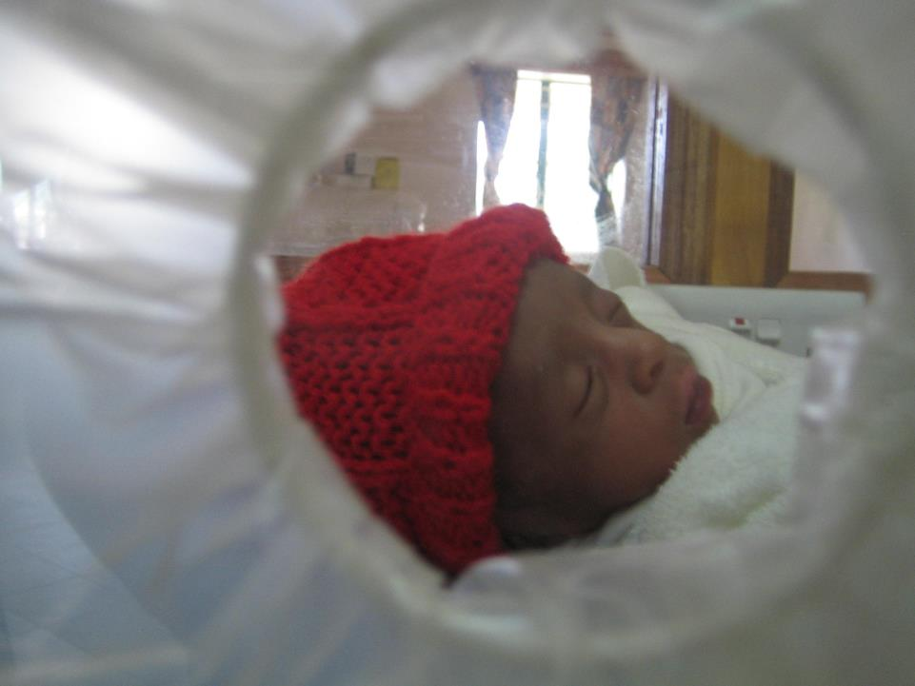
A premature baby in one of our incubators

Slide 33
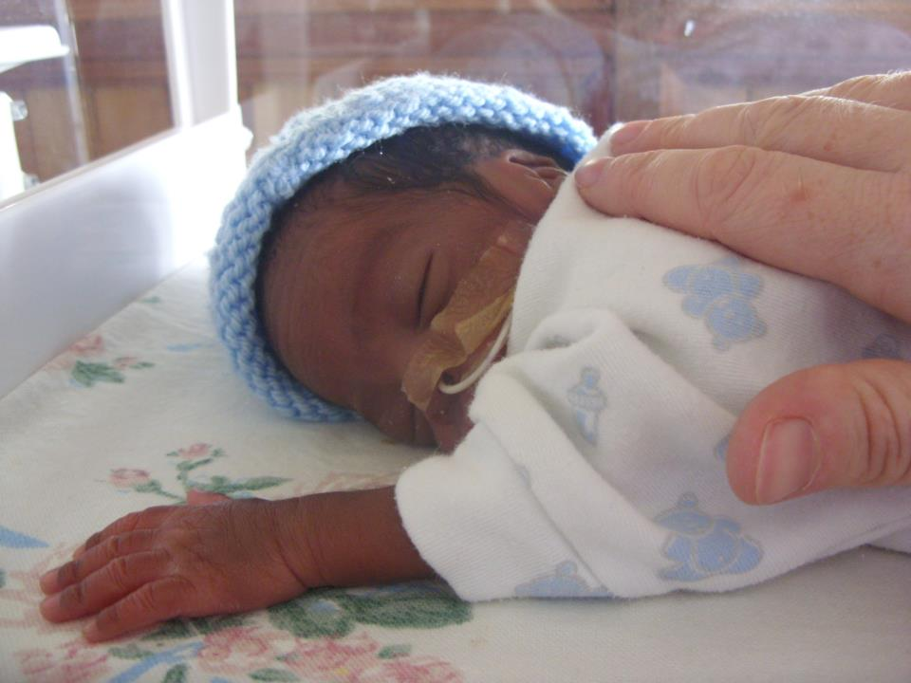

Slide 34
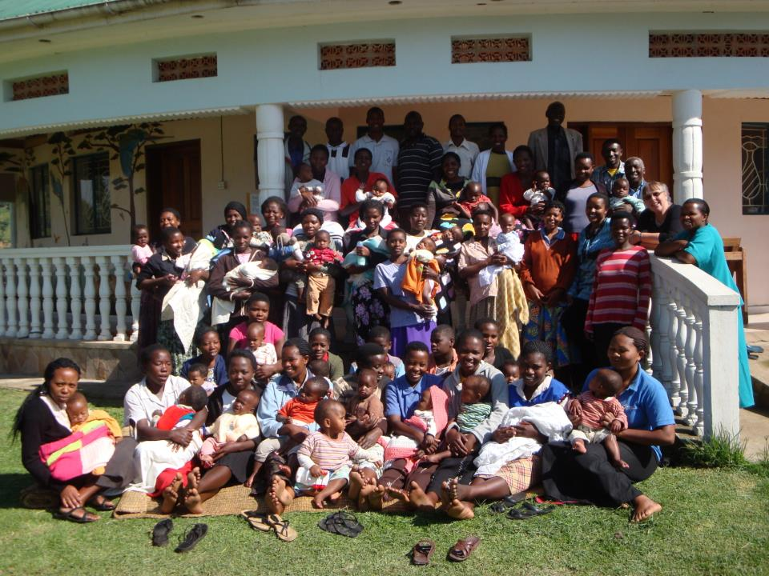
Thank you for your support

Slide 35
