Slide 1
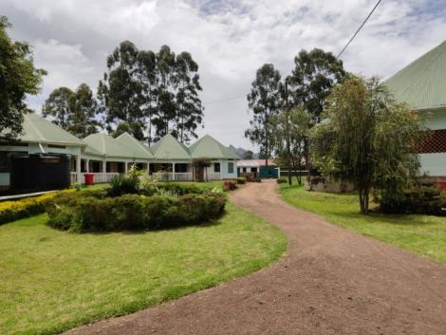
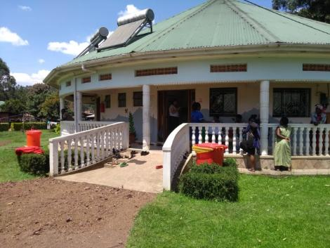
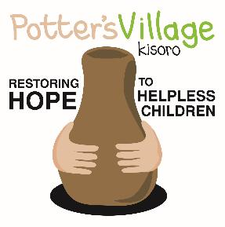
Potter’s Village
Kisoro, Uganda

Slide 2
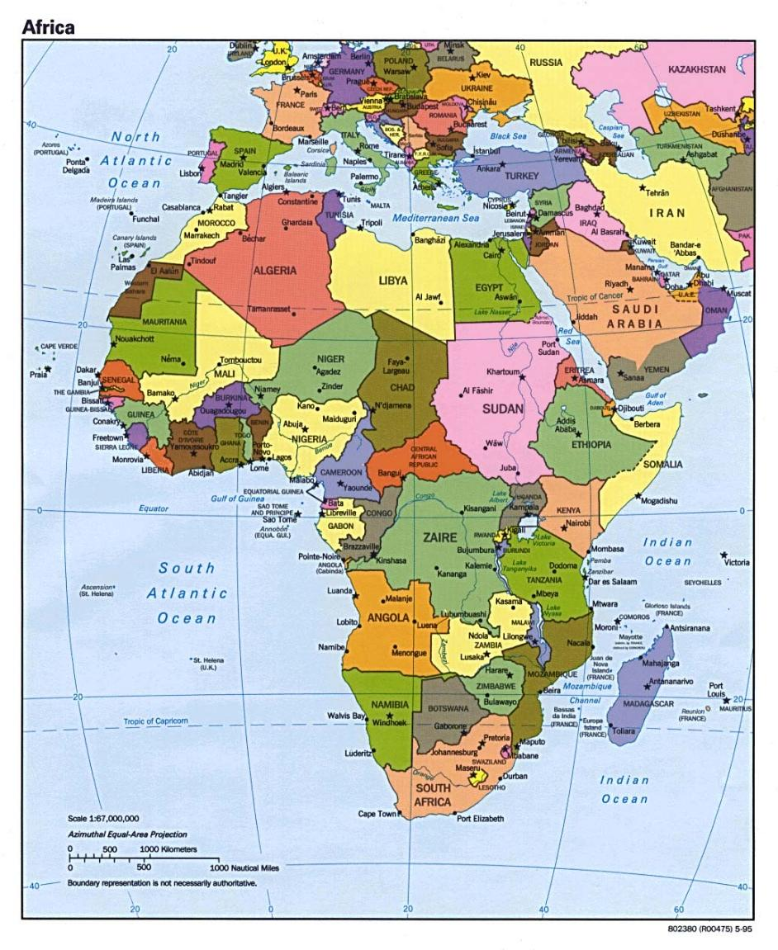
Uganda
is in East Africa
On the
equator

Slide 3
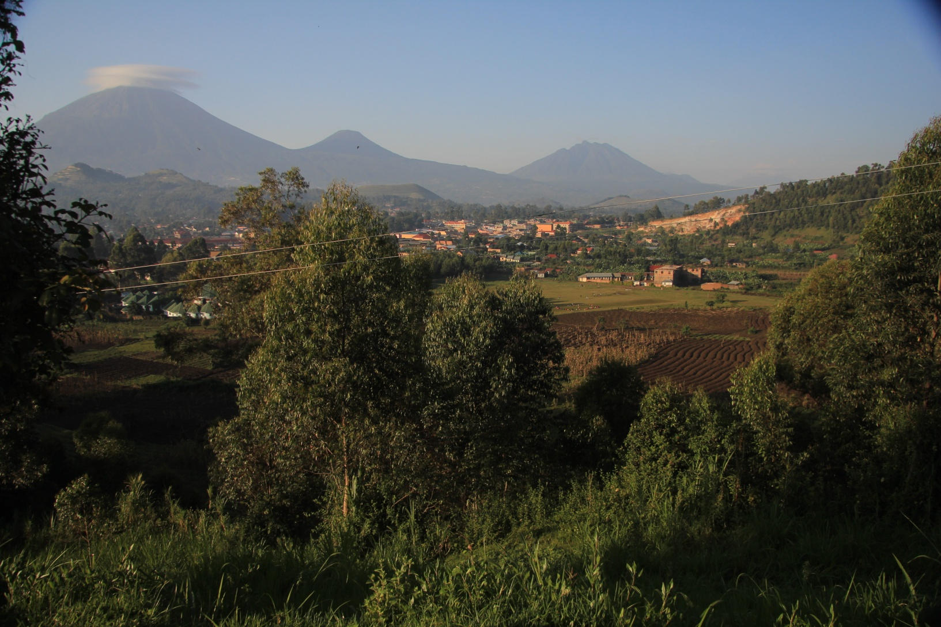
The town of Kisoro is located in the SW corner of Uganda near to borders of Rwanda and the Democratic Republic of Congo
and is dominated by these extinct volcanoes

Slide 4
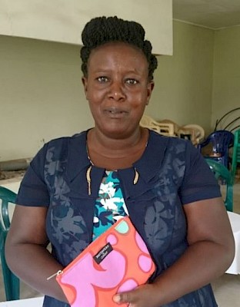
Idah
Kyarimpa
is
Potter’s
Village
Administrator

Slide 5
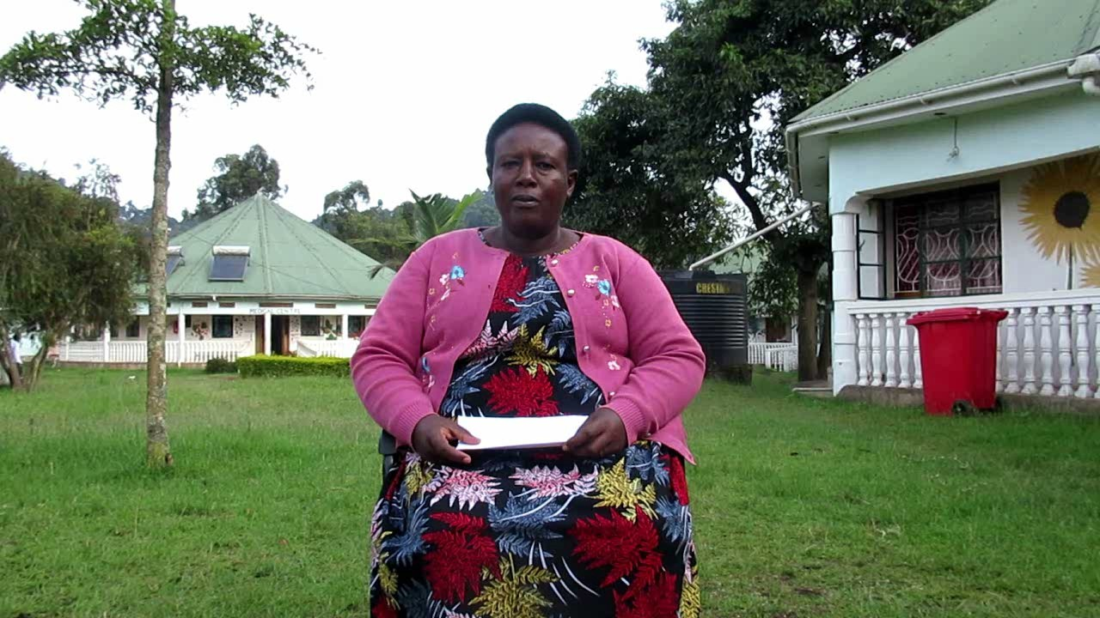
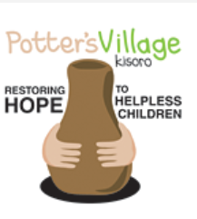
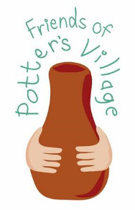
POTTER’S VILLAGE KISORO
GENERAL OVERVIEW OF POTTER’S VILLAGE TODAY.
By Idah Kyarimpa –Administrator

Slide 6
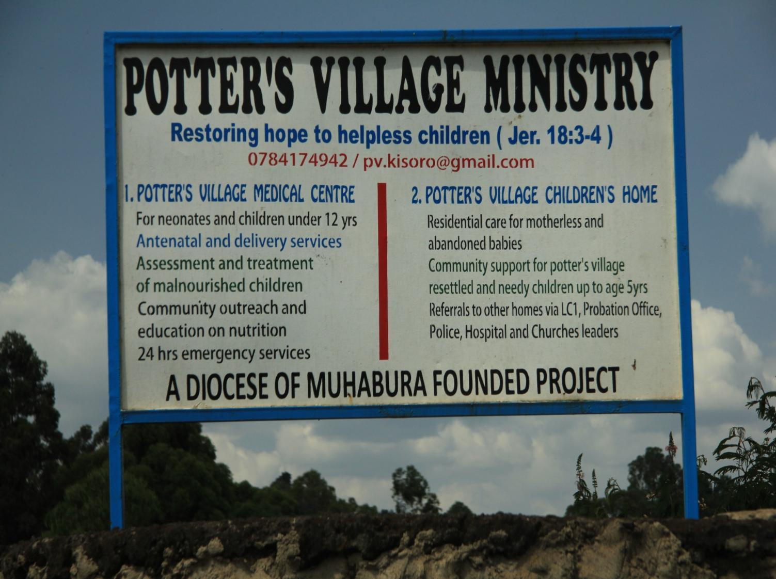

Slide 7
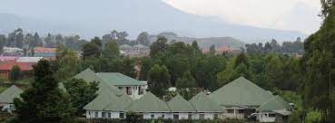
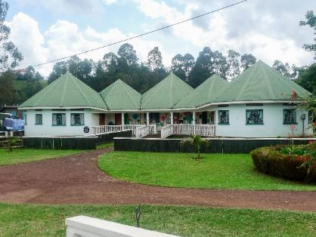
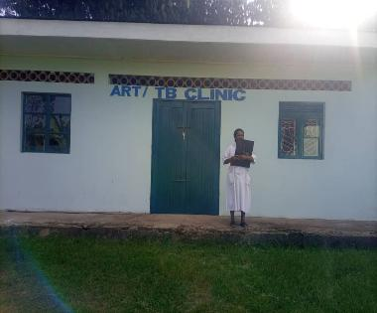
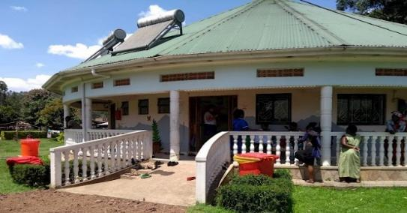
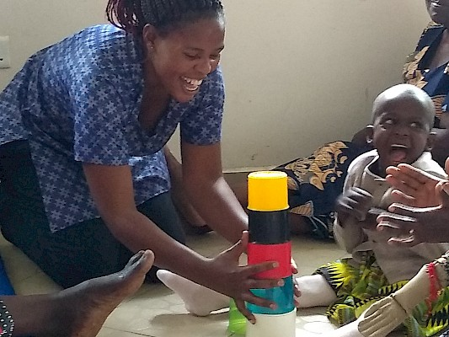
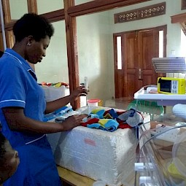
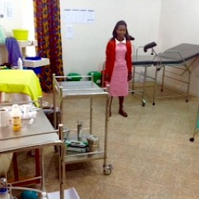
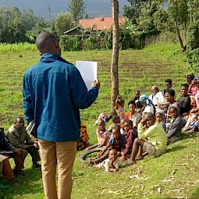
Potter’s Village
Crisis centre
ART / TB Clinic.
Medical Centre
Paediatric Unit and maternity care
Disability Rehabilitation Centre.
Neonatal Unit
Nutrition Unit

Slide 8
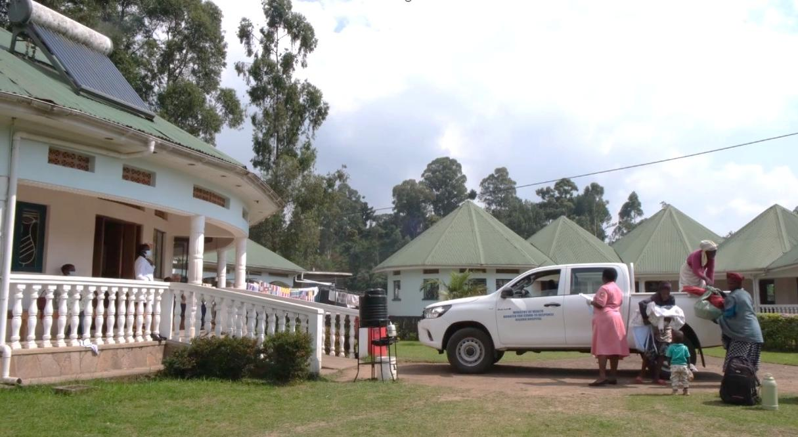
Medical Centre
During Oct 2025 the Medical Centre treated
over 305 outpatients and 48 who were inpatients

Slide 9
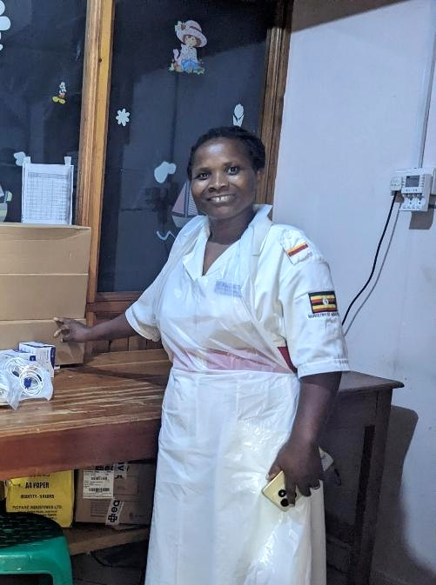
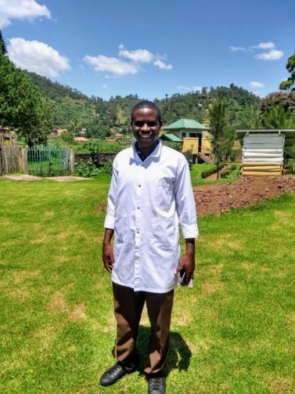
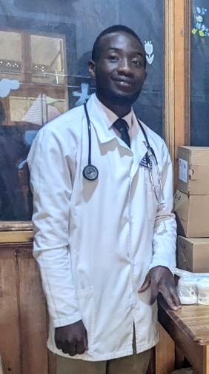
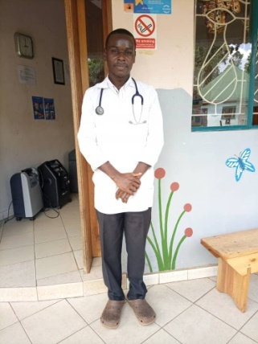
Medical Centre Senior Staff
Davis, Rodgers and Sam are the three full time Clinical Officers.
Their role is to see and treat all the children
in the outpatient clinic and on the wards
Jovia,
Senior Nursing
Officer

Slide 10
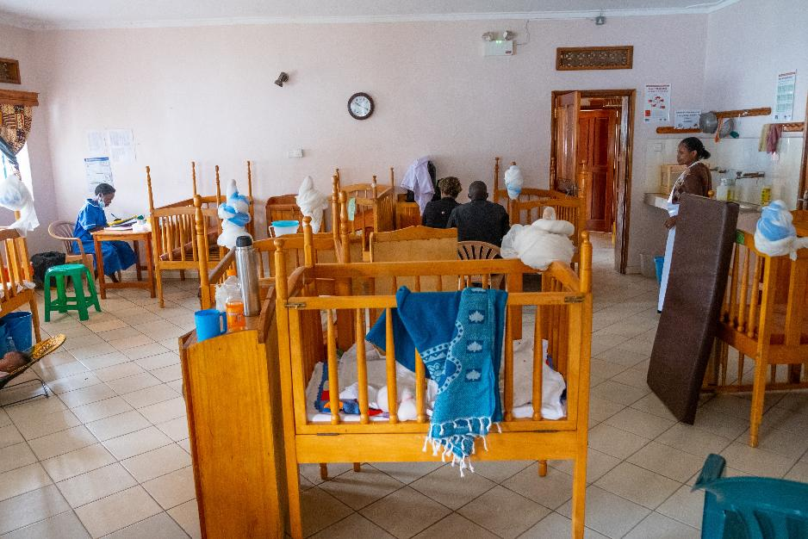
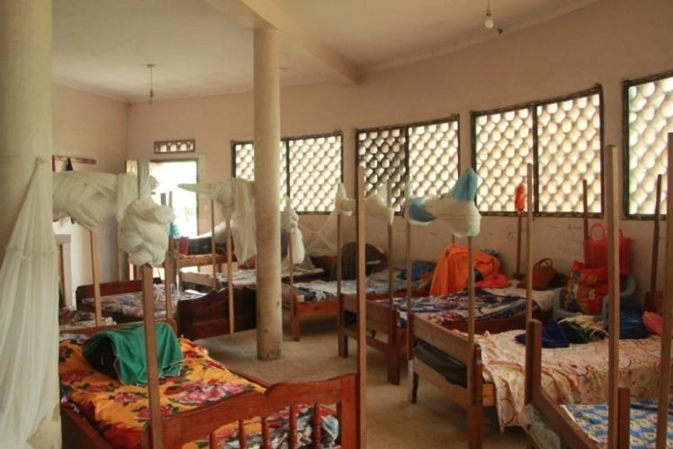
One of the
Children’s Wards
Dormitory for mothers
of babies and children
admitted for medical
treatment

Slide 11
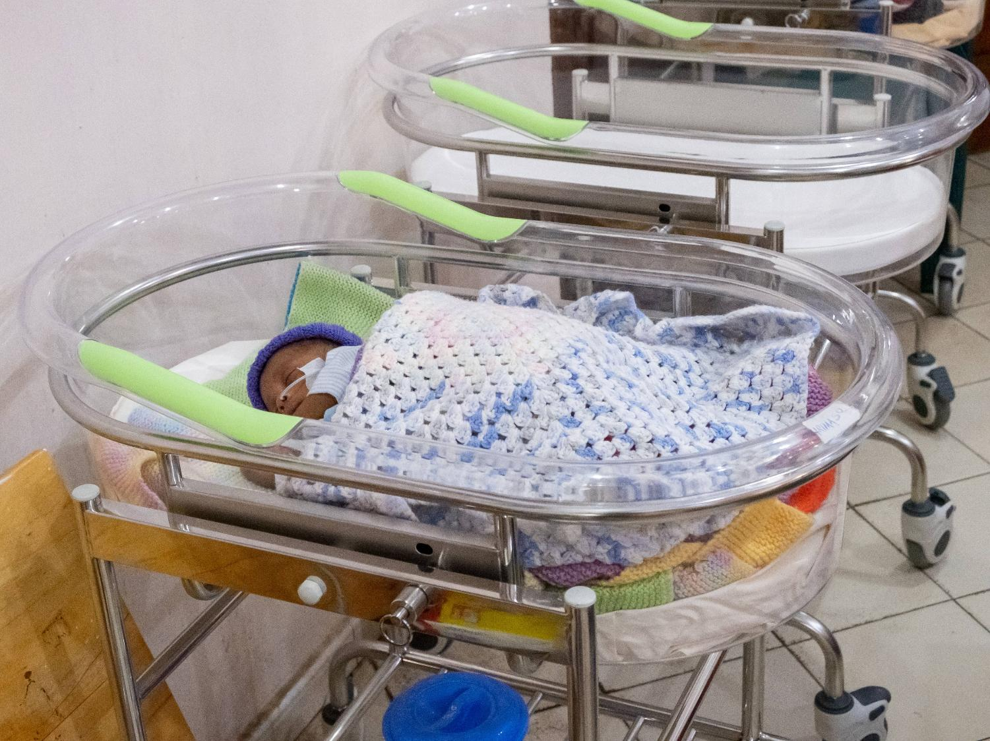
The Neonatal Unit
The neonatal unit can care for up to 20 babies. In 2023 these cots were donated to the unit by a Rotary Club in the UK.

Slide 12
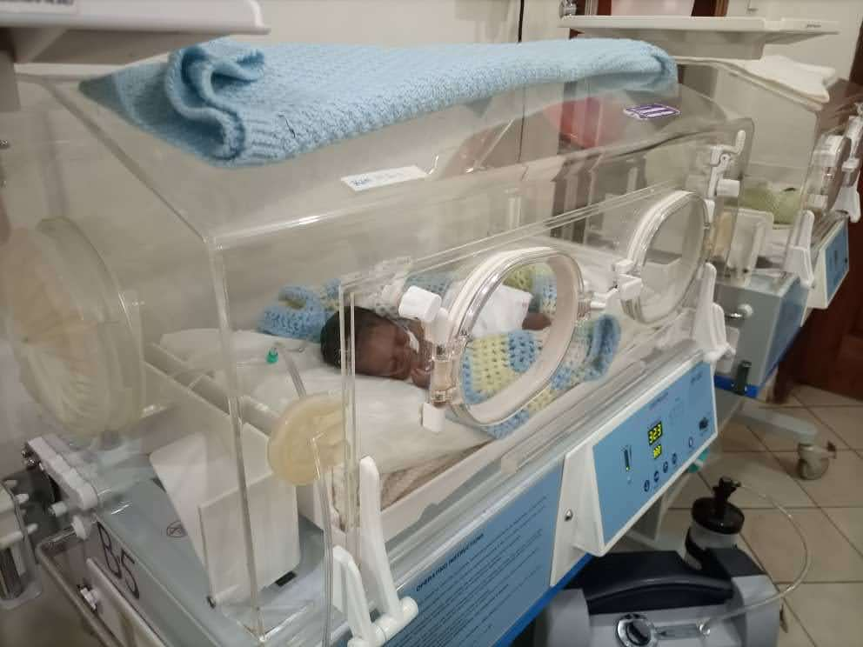

Slide 13
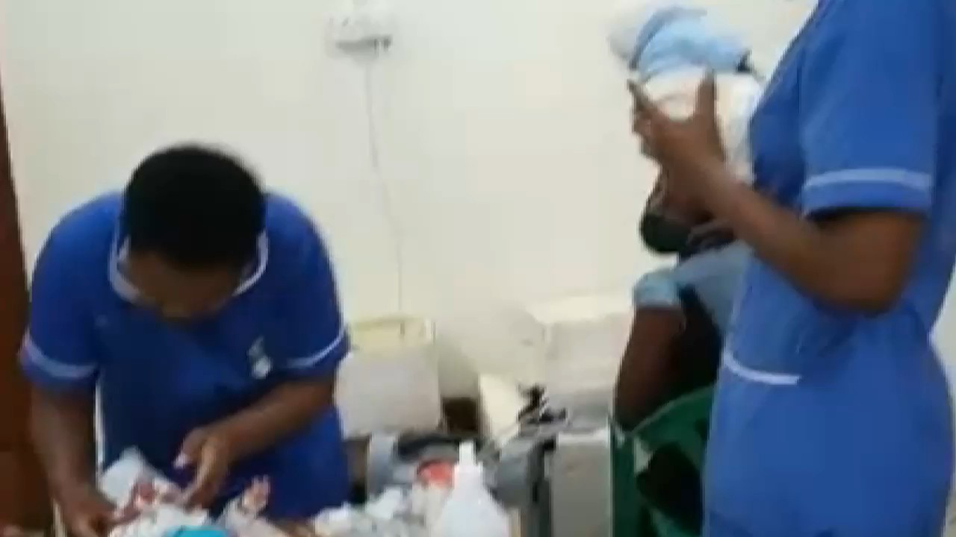

Slide 14
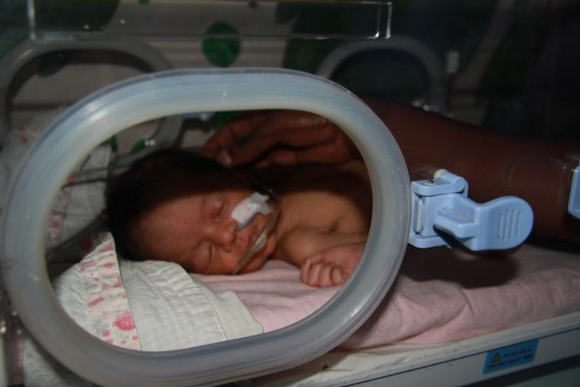
Idah says:
The neonatal baby unit at Potter’s Village is the only one in the whole District,
actually in the
whole of western Uganda!

Slide 15
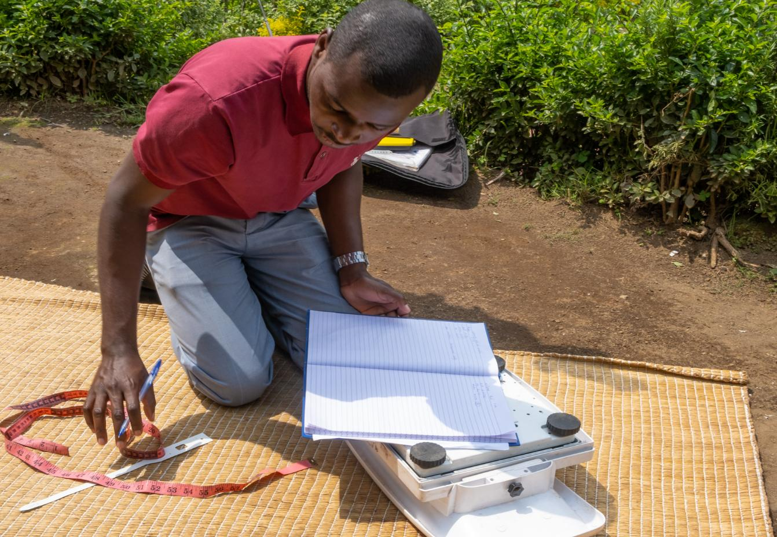
Nutrition Unit
Often when children are admitted to the Medical Centre, they are found to be malnourished. Rodgers, the Clinical Officer, will continue to follow them up after discharge and also gives talks on healthy nutrition in the community.

Slide 16
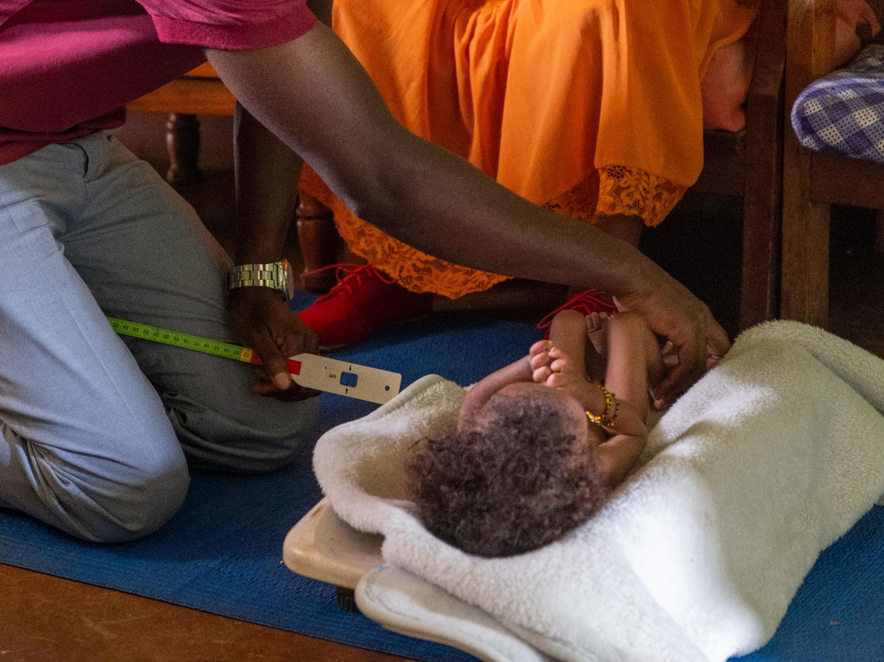
Rodgers carries out some simple measurements to determine if a child is malnourished and needs extra support from Potter’s Village

Slide 17
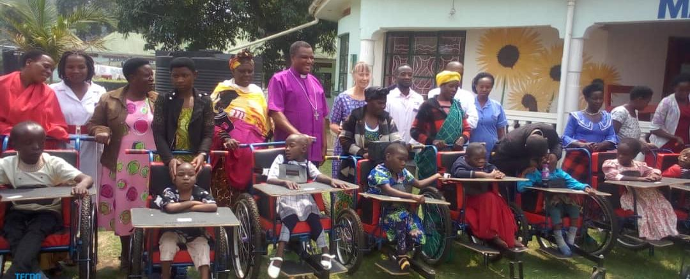
The Disability Rehabilitation Unit was set up by Janie Robson, a physiotherapist from the UK, in 2019. The wheelchairs were funded by the diocese.

Slide 18
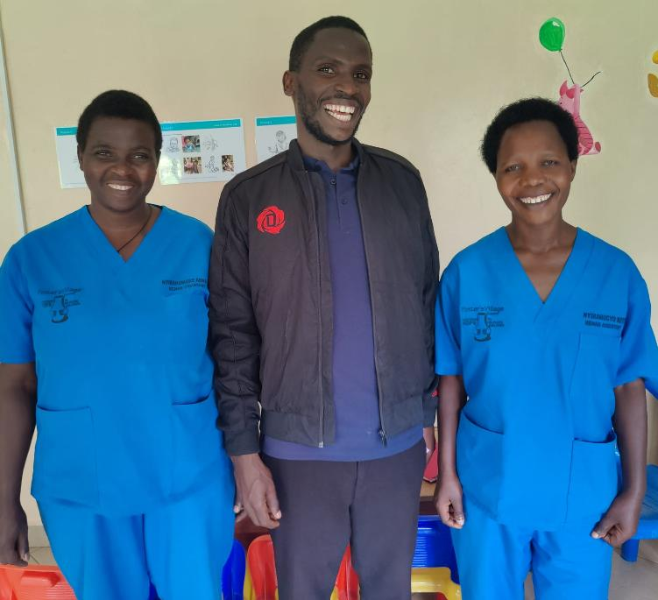
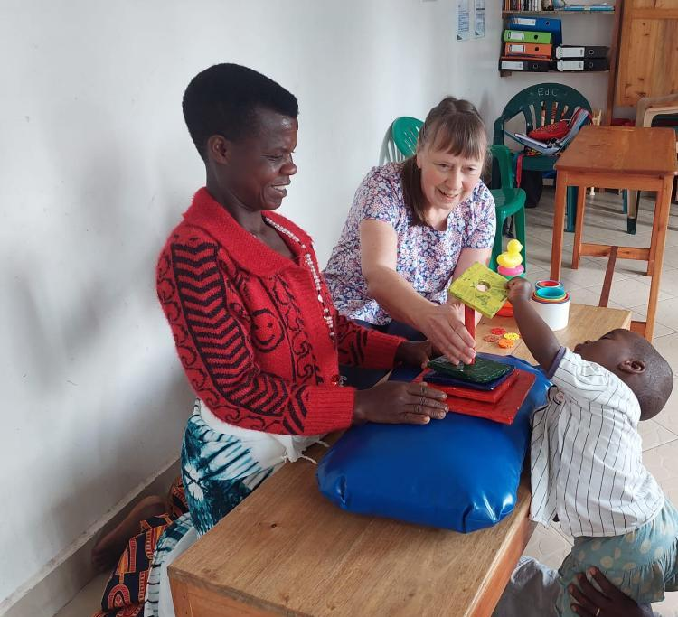
The Rehab Centre team consists of Physiotherapist Crissy and nurses Keti and Annah are supported by Janie Robson

Slide 19
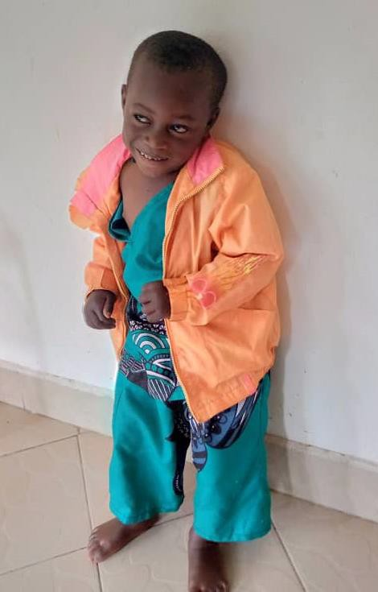
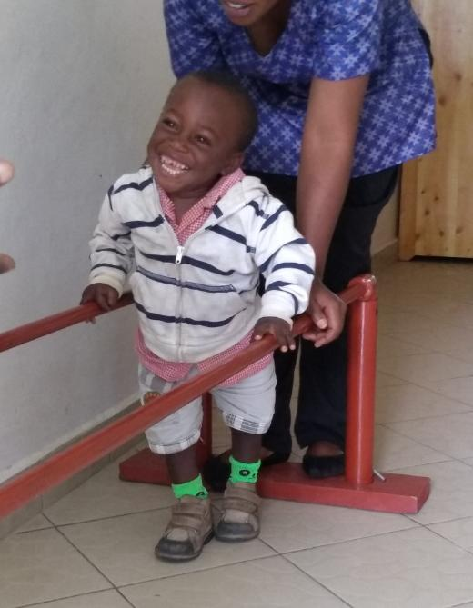
This little boy has Cerebral
Palsy and by the age of 3
he could only just sit up.
But after a year’s treatment
he can now crawl, stand
and walk a little.

Slide 20
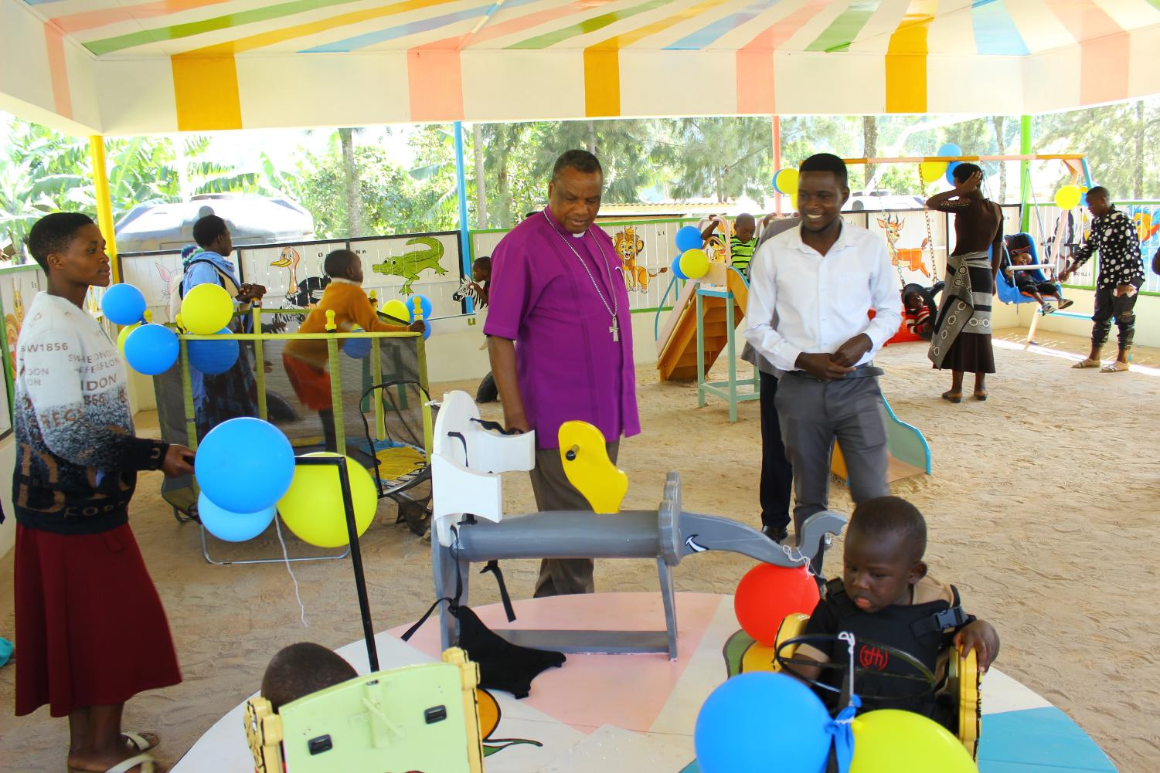

Slide 21
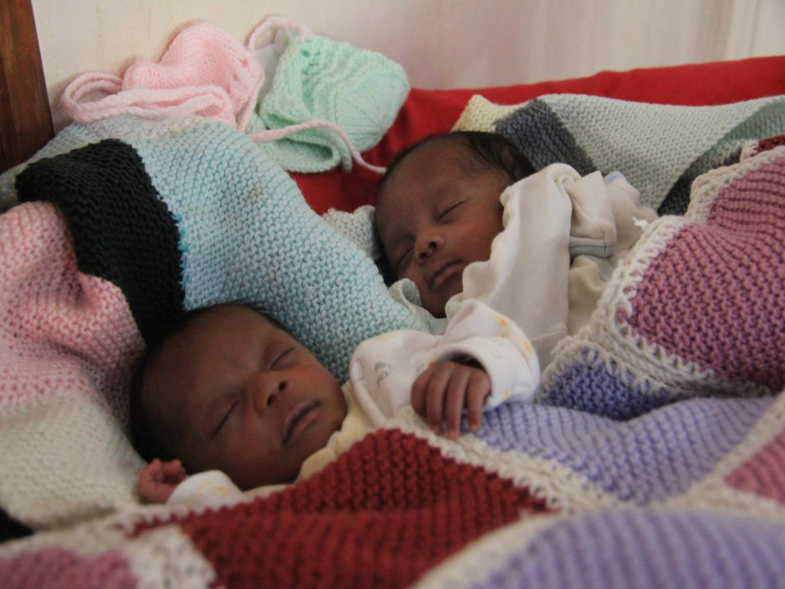
Potter’s Village began as a Crisis Centre for Babies

Slide 22
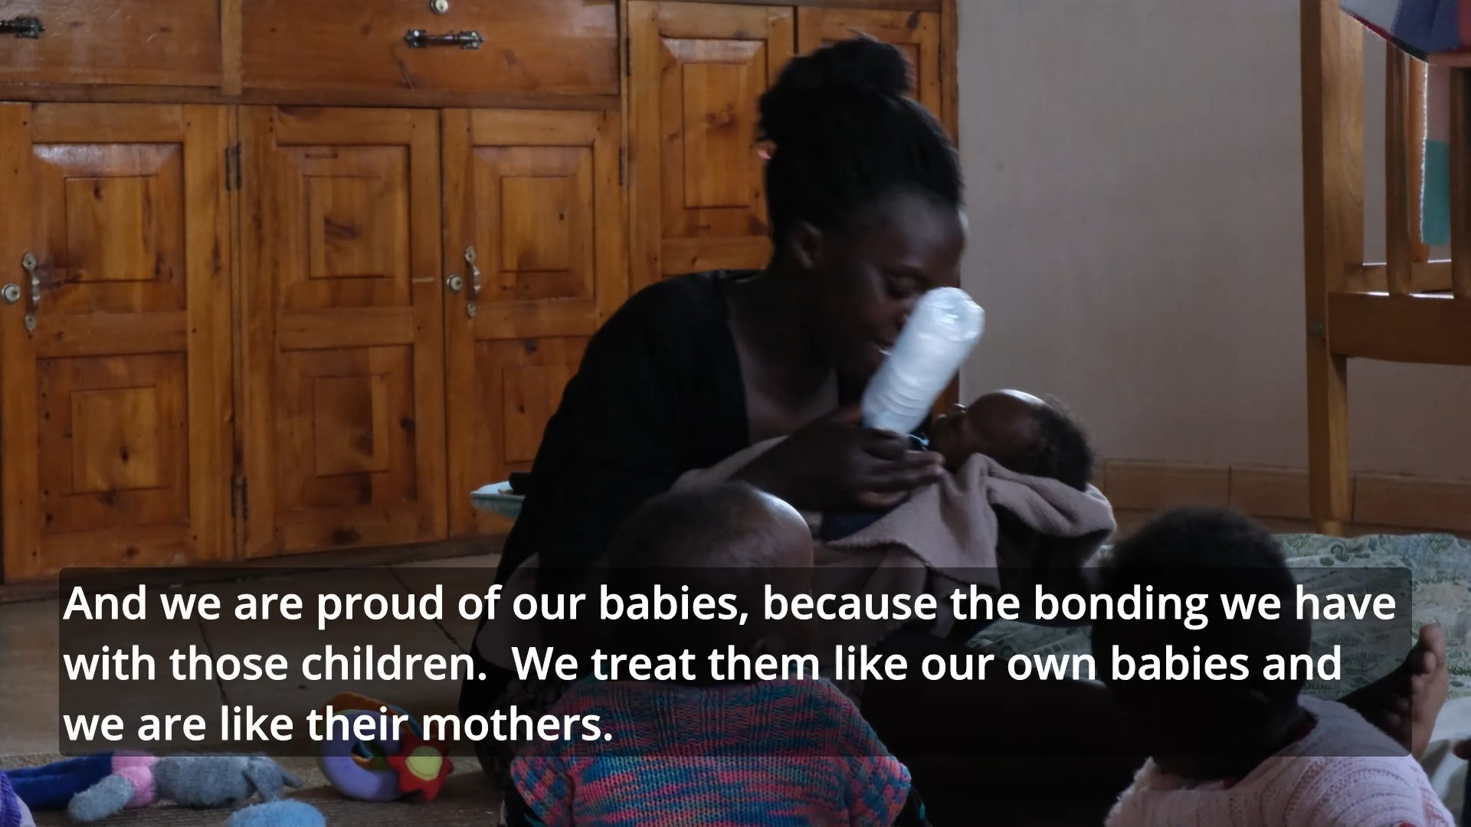
Video of crisis centre

Slide 23
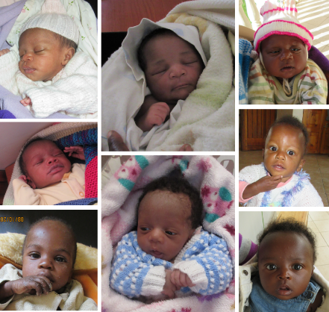
Resident Babies
Babies come to us because they have been abandoned or their mothers have died soon after childbirth, or the
mothers suffer from
untreated mental illness.
In January 2026 we
admitted four new babies. Two of these babies had sadly lost their mothers soon after birth and the other two have mothers who have mental health difficulties.

Slide 24
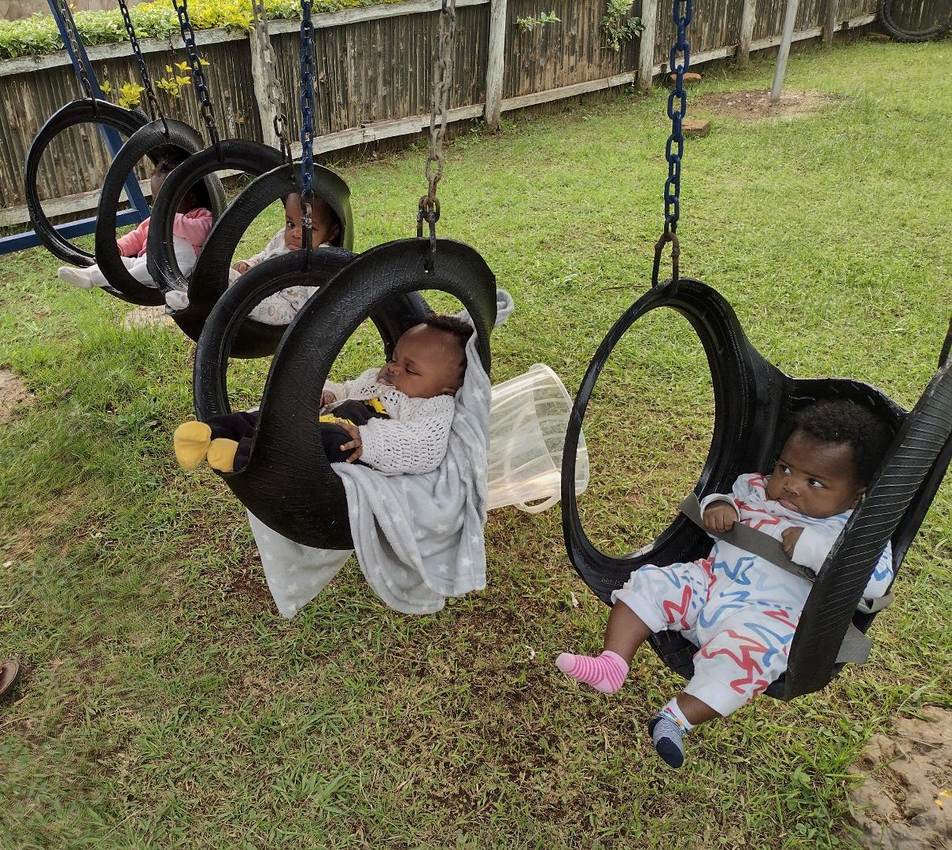

Slide 25
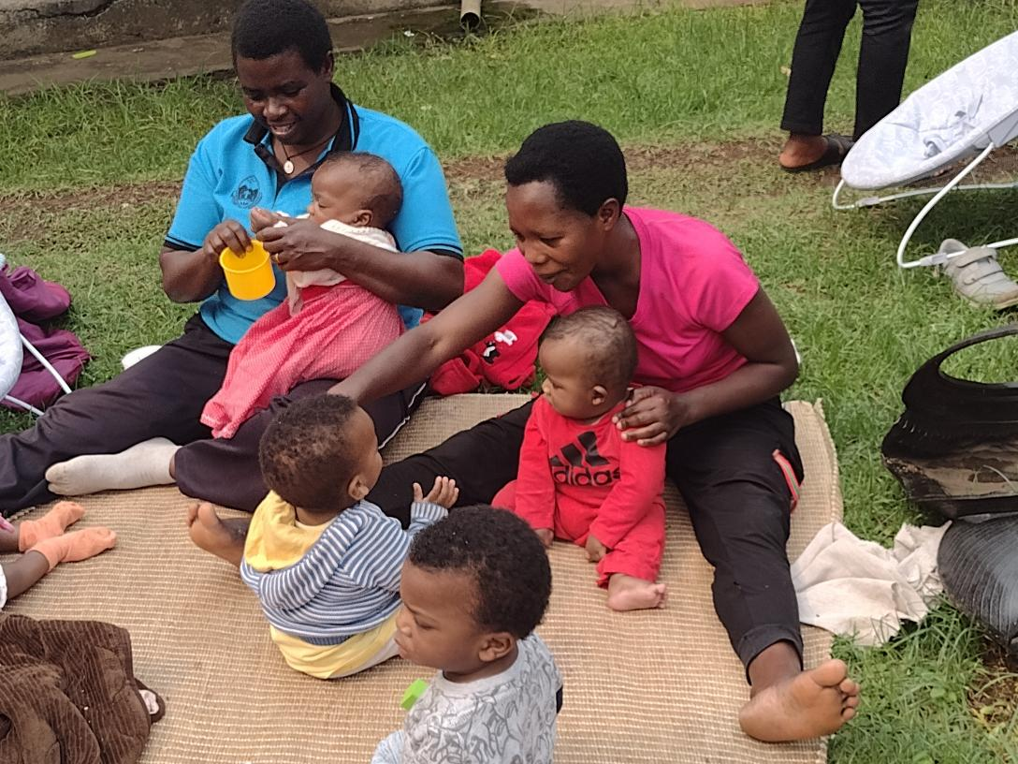
Annah and Keti from the Rehab Unit are also able to work with the
babies in the Crisis Centre

Slide 26
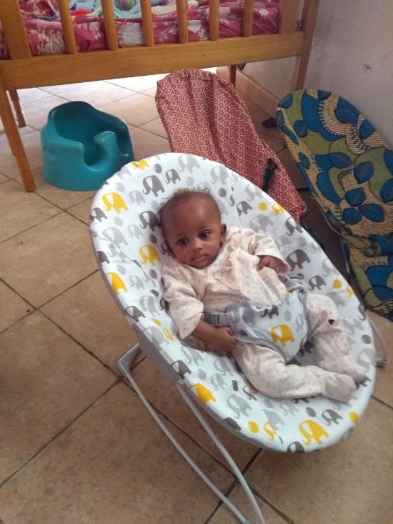
Idah says:
“We would love them to go to families so that they are able to bond with the family members and so they grow up knowing this is the family they belong to.”
Once they are weaned, the aim is to re-settle them
back with their families and to continue to support them with food and financial aid until they are old enough to attend school.

Slide 27
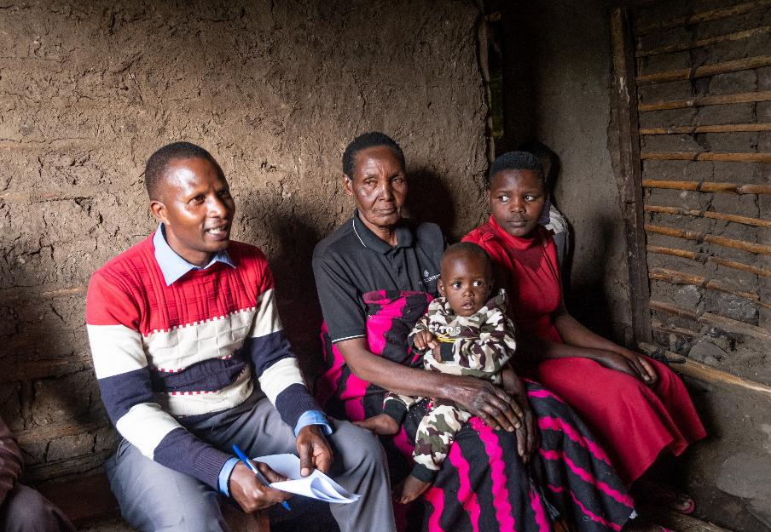
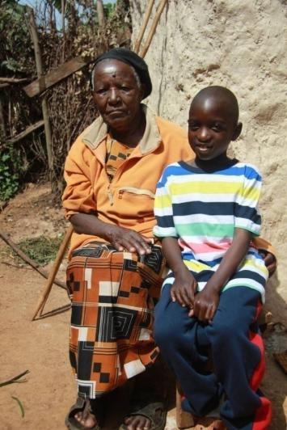
Poverty, elderly relatives struggling to care, poor maternal mental health can all affect the child’s well being, and so staff monitor their progress and give help where needed.

Slide 28
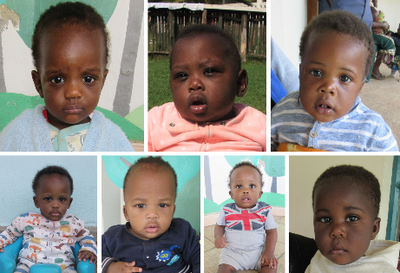
Some babies have no family to look after them. Fostering is not common, and Idah says “We are trying to inspire folk to get a heart for fostering and take in the weaned babies”
In January 2025
we re-settled
three children:
Two returned to
their families and one went into foster care.

Slide 29
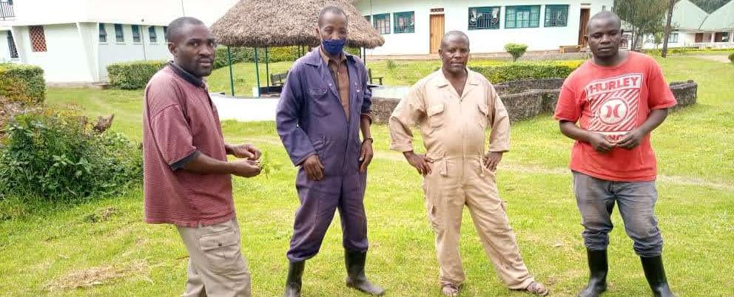
Altogether Potter’s Village employs over 60 local people, including medical staff, baby carers, kitchen workers, gatekeepers and the compound team.

Slide 30
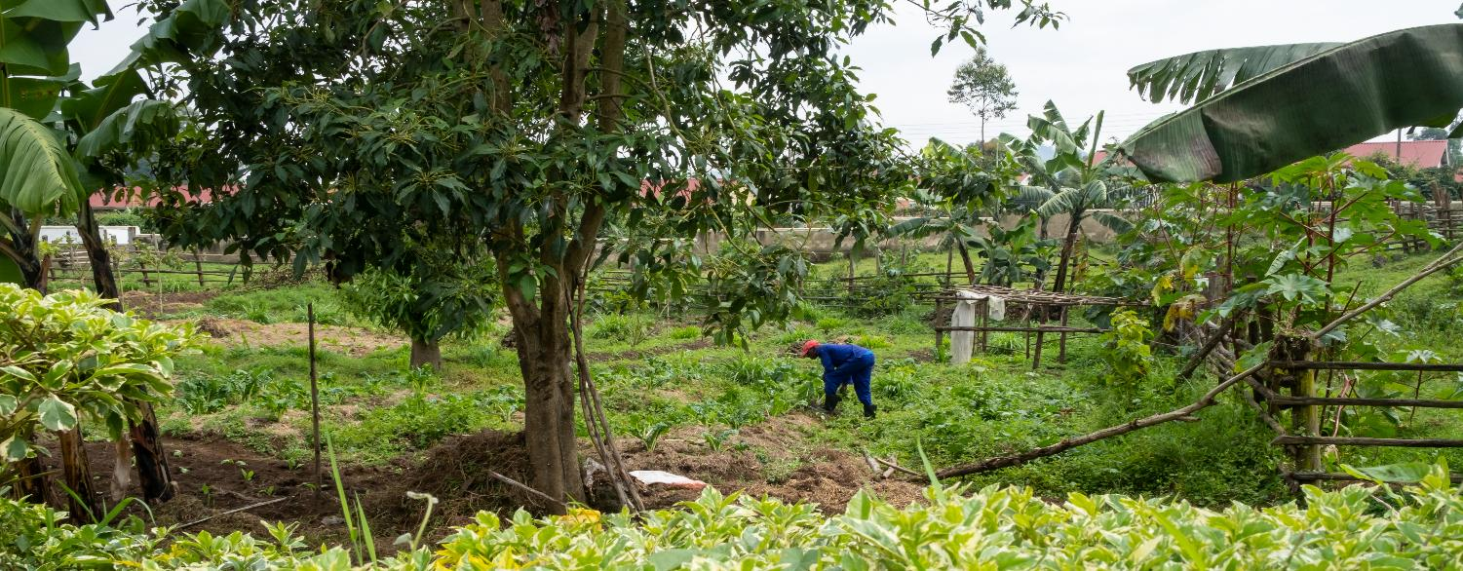
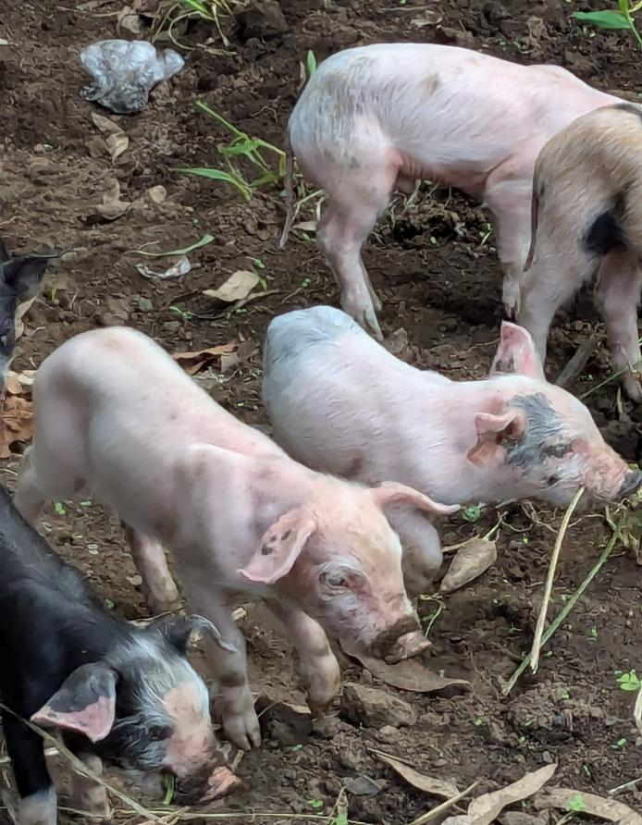
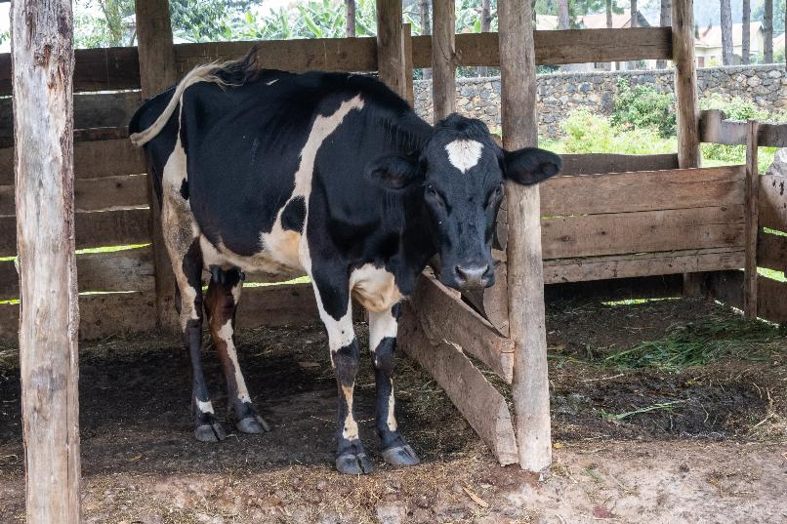
Vegetables are grown and pigs and cows are raised on site. These provide food and milk for the children and can also be sold to provide an income.

Slide 31


Idah says “Thank you to the staff. If we work together Potter’s Village will shine.”

Slide 32

Children’s Crisis Centre
Idah says: We pray that we
shall be able to always give
that excellent service
that the community needs

Slide 33
“Finally I want
to thank everybody
that has participated
in the wellbeing
of this place;
everybody that has
participated in the
wellbeing of the
babies. We are so glad that these children have been given hope;
these children have been helped to survive.

Slide 34

Friends of Potter’s Village
is the UK Charity that supports and
fundraises for Potter’s Village.
We want to add
our thanks for all
your support.
Charity No. 1173948

