Slide 1
Friends of Potter’s Village
Child sponsorship
&
Regular giving

Slide 2
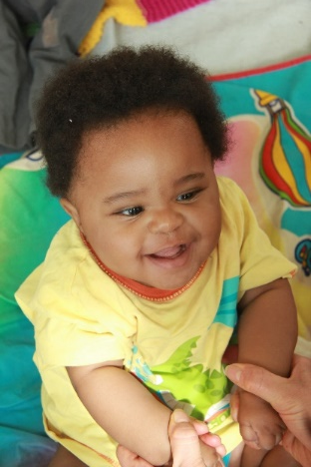
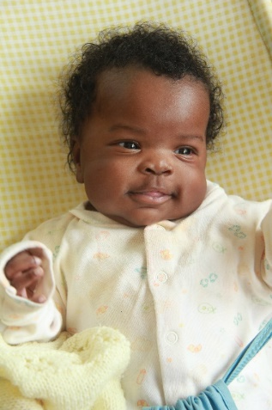
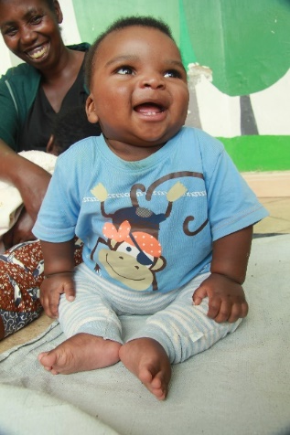
Thank you!
Amy
Joan
Martin
Barbara
Philip
Jenny
John
David

Slide 3
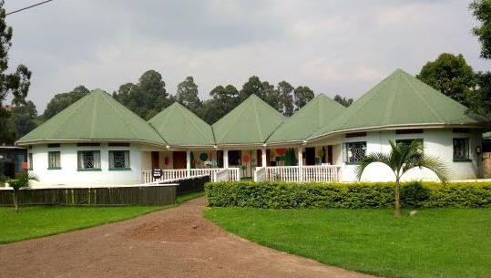

Slide 4
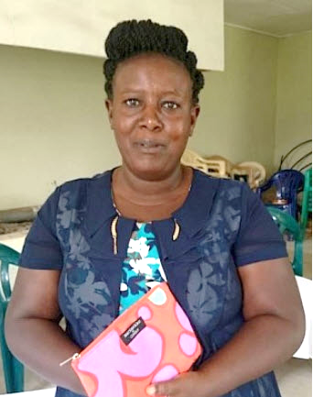
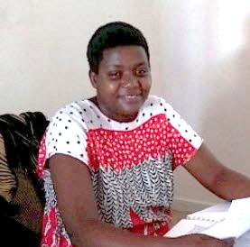
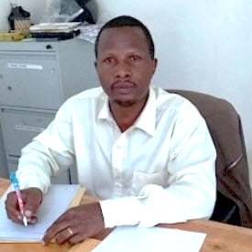
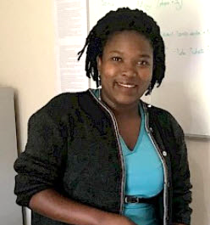
Idah
Winnefred
Festo
Sonia

Slide 6
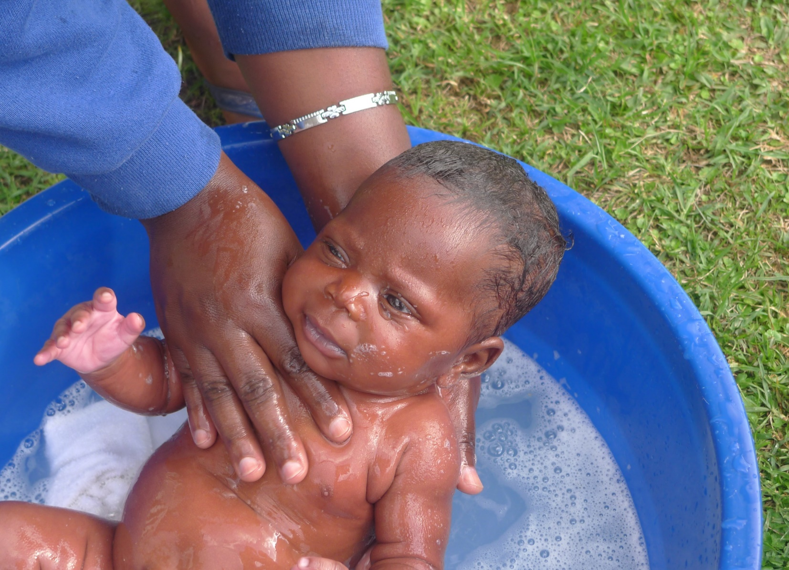
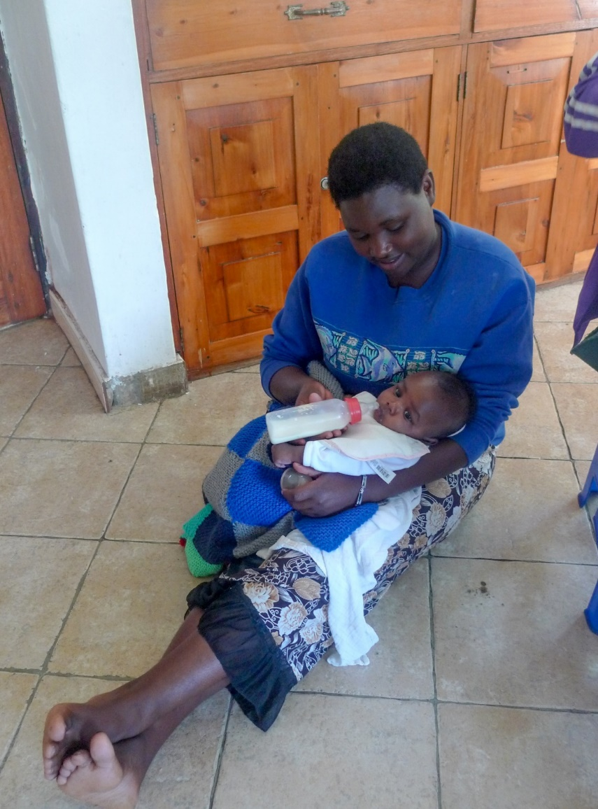
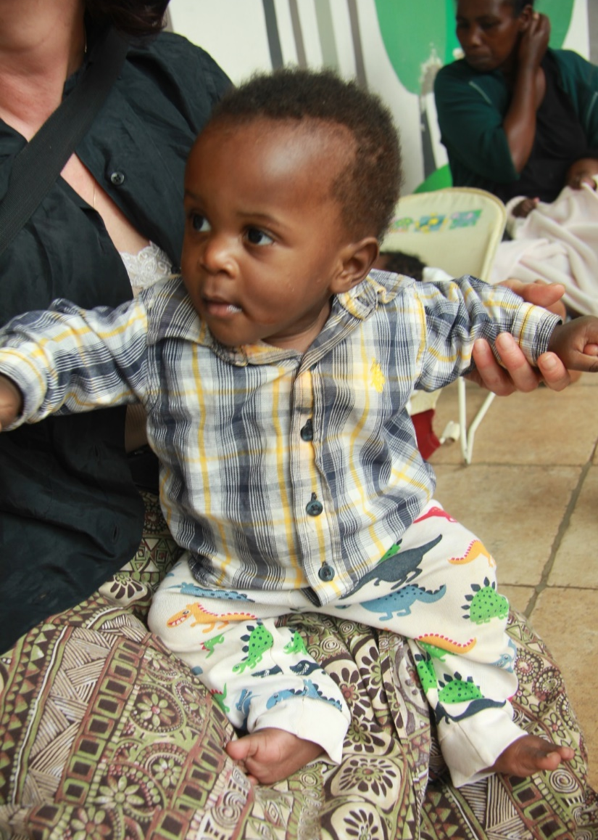

Slide 7
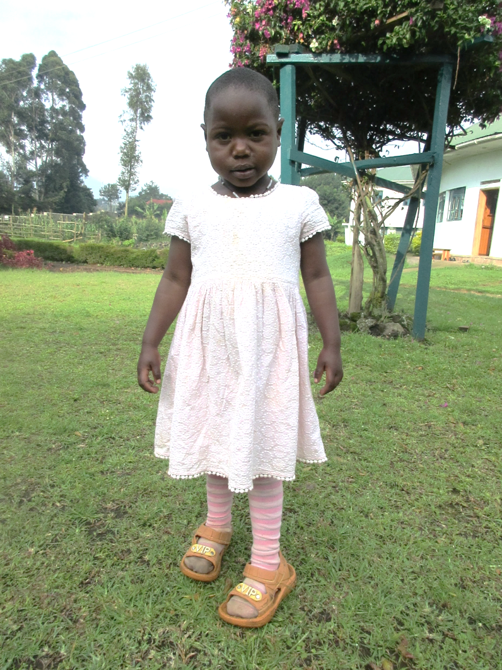
Dear J…..,
Thank you for your continued support of Potter’s Village through your sponsorship of M….., for whom I now have a brief update.
“She was due to join school but because of the covid-19, schools have not yet opened for the beginners. She is around 4 years, looks well, and is happy. The family is saving her community support money to use for school fees and they bought some sheep for her which have multiplied to 5.”
I have attached a recent photograph and a letter with news from Potter’s Village.

Slide 8
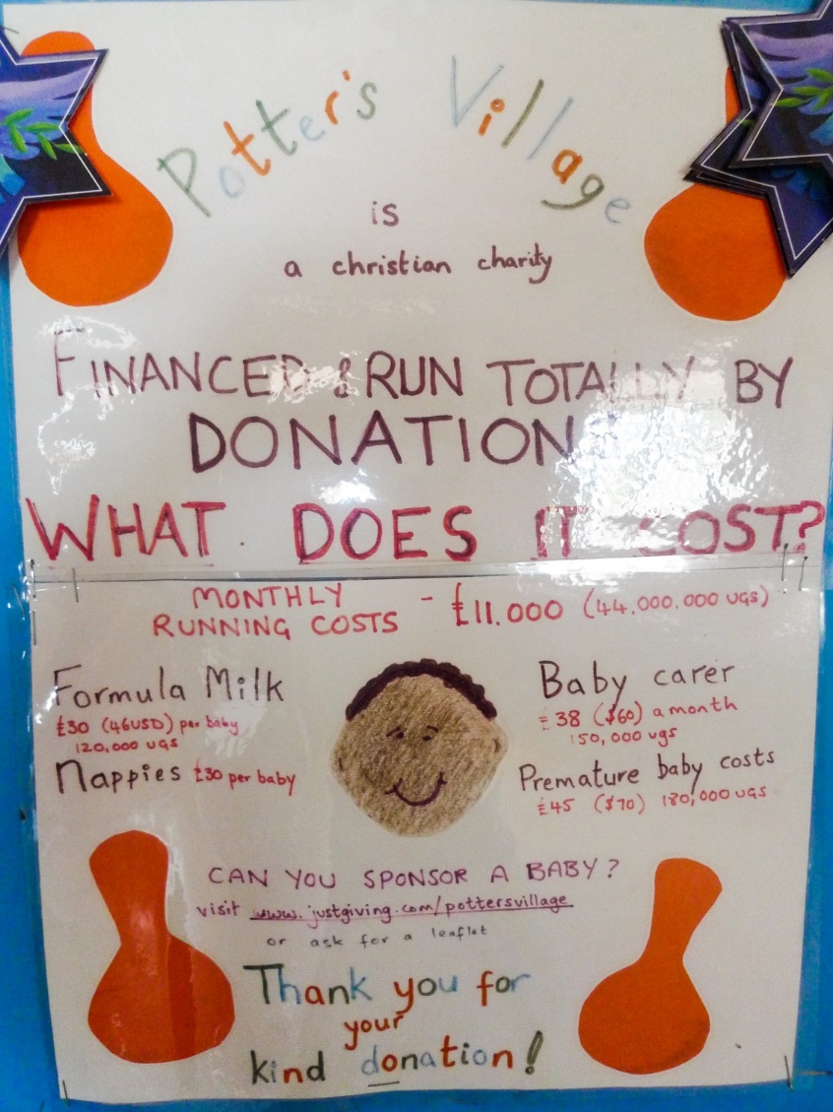

Slide 9
How to set up a regular donation
Visit our website at www.pottersvillage.org.uk and click the donate button
You can either:
Request a standing order form for Child or general sponsorship
Set up a Direct Debit through CAF donate or Just Giving
For any queries contact sponsorship.pottersuk@gmail.com

Slide 10
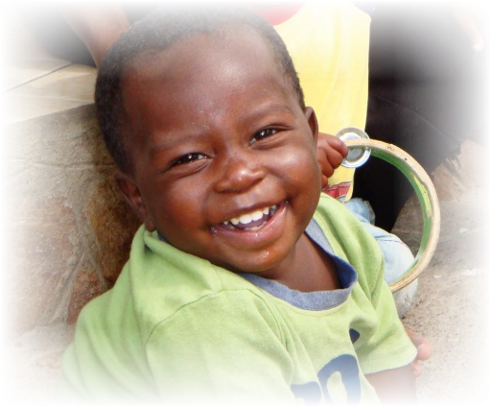
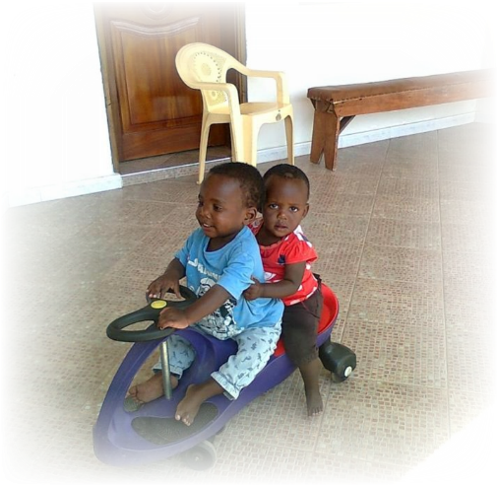
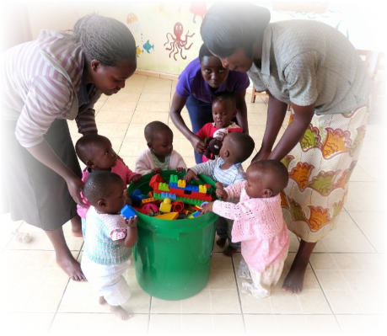
The greatest reward is when children are restored to a stable family life
We have photos of the children on our fridge to remind us to pray for them
A wonderful way to show God’s love
It’s wonderful to get updates about Ezra and to hear he is doing well with his maternal family
It was a privilege to be involved with Joanne’s support after falling in love with her at Potter’s Village

